Slide 1
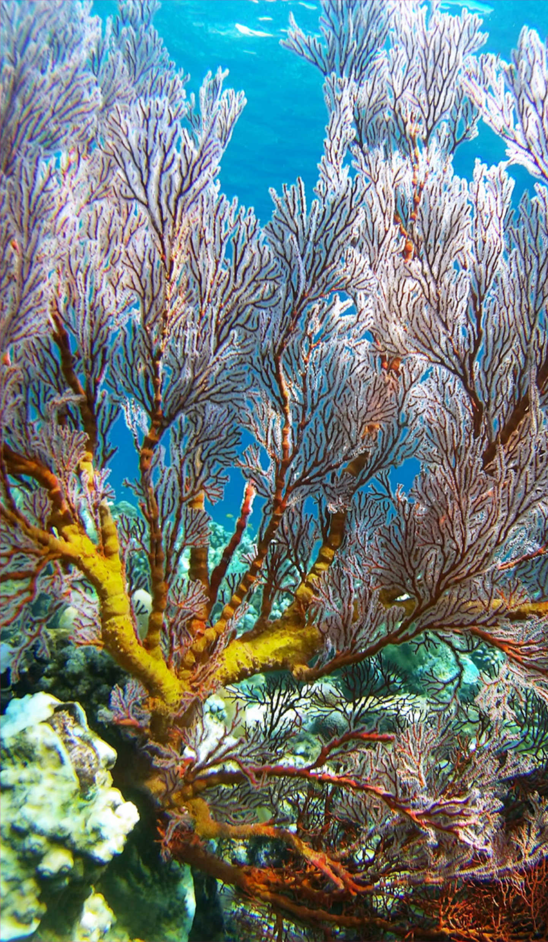
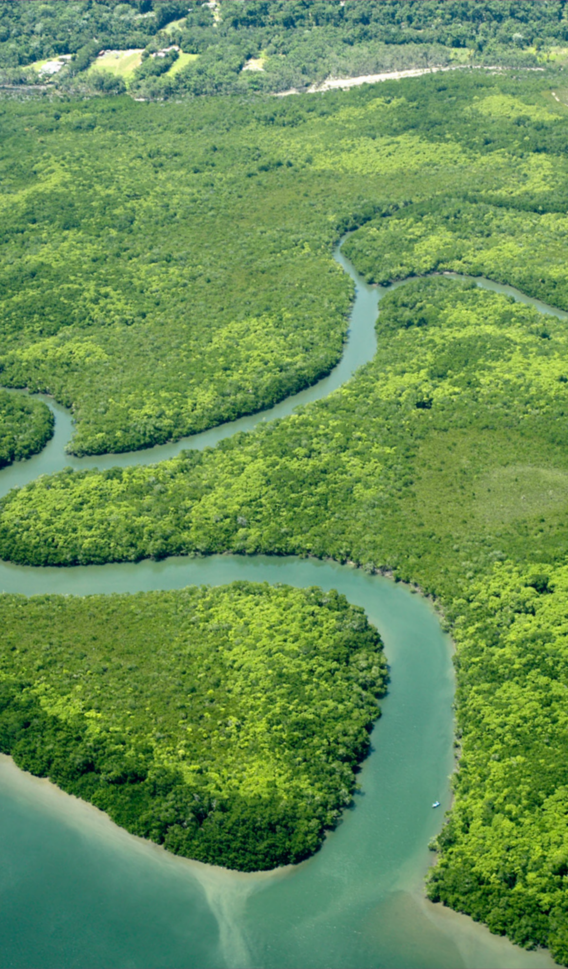
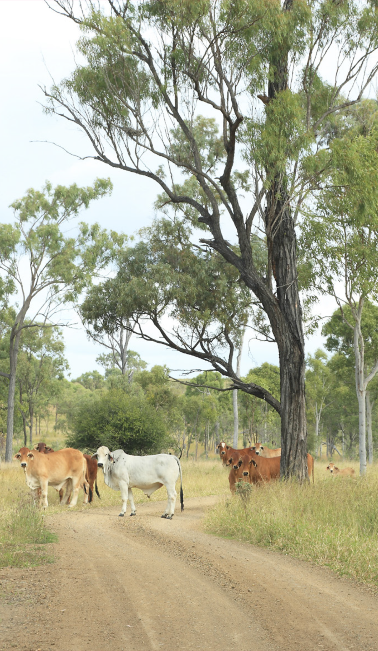
Burdekin Regional Science Forum
Overview of the Paddock to Reef Integrated Monitoring, Modelling and Reporting Program and Reef Water Quality Report Card 2021 and 2022
Notes:
Thank you for having us here today to talk Water Quality.
It’s great to be with you all and we look forward to discussing ways in which we can work together to ensure that the Reef remains in good health.
There are several of us from the Department, and you will be hearing from us on several aspects today.
My talk is around how we are tracking with the Reef Water Quality Targets.
All slides previously approved as part of WQIP seminar #7

Slide 2
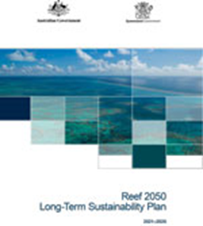
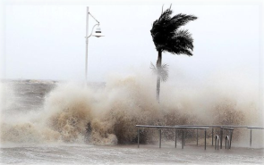
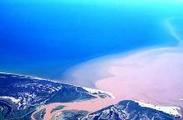
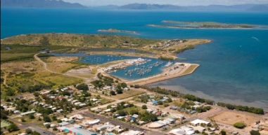
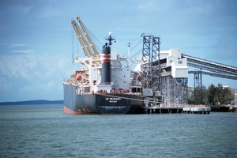
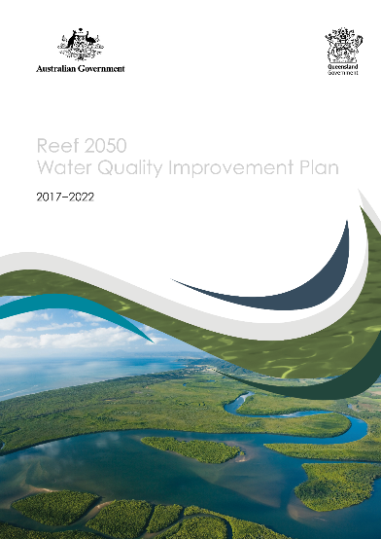
Reef Water Quality Targets
Threats to the Great Barrier Reef
Climate
change
Land based
run-off
Coastal
land use change
Direct
use
Targets
Nutrients
Fine sediments
Pesticides
Notes:
I should begin by distinguishing between the term “Reef”
When we talk Reef, we talk about inshore reef
That is the region of the catchment, ecosystems and sea grass
Reef wide refers to the whole Reef
The Reef is under quite a few threats.
Climate Change is obviously the greatest threat and the evidence of its impact is backed by the latest Scientific Consensus Statement. At this point, I would like to note that we do have Jane Waterhouse from C2O Consulting present who will discuss this in more detail when presenting the Scientific Consensus Statement.
All of the above impair coral growth and the Reef’s resilience overall.
There also are other threats like land based runoff and coastal land use change.
These are of interest to us all, because they are within our control and allow us to make a positive difference to Reef water quality.
Good water quality:
Allows greater reef resilience.
Improves water quality
Builds resilience in inshore coastal and seagrass areas which support significant biodiversity such as turtles and dugongs, and drive fisheries productivity.
Land-based Run-off contains nutrients, sediments and pesticides.
All of these affect the:
Water quality
Biodiversity and
Health of the living things around the Reef
Nitrogen discharge is associated with increased algal growth
Fine sediment discharge reduces the light available to seagrass ecosystems and inshore coral reefs.
Pesticides pose a risk to freshwater and some inshore and coastal habitats
Coastal land use change includes clearing and modifying coastal habitats and creating artificial barriers to flow.

Slide 3
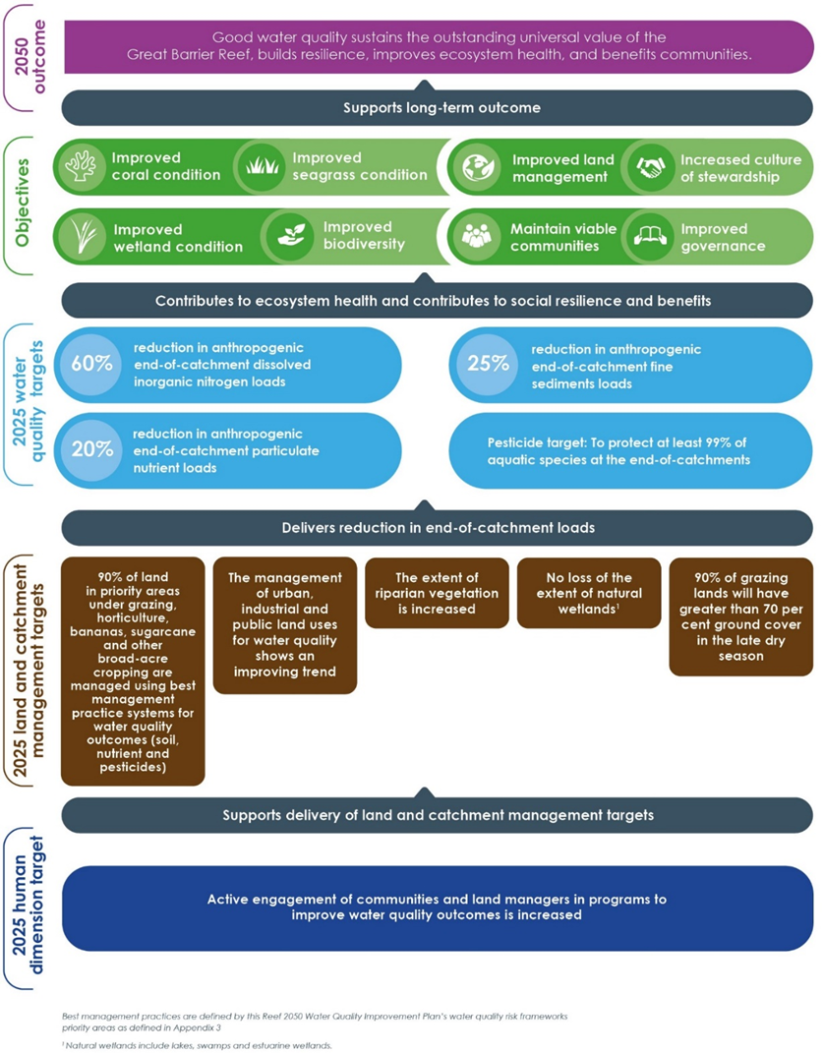
Reef 2050 Water Quality Improvement Plan
The Reef 2050 Water Quality Improvement Plan set targets to be achieved by 2025.
The Paddock to Reef program uses monitoring and modelling to report on the progress towards targets and objectives which are reported in a Reef Water Quality Report Card.
The Reef Water Quality Report Card 2021 and 2022 was released in May 2024.
Notes:
The Reef 2050 Water Quality Improvement Plan 2017–2022 is a joint commitment of the Australian and Queensland governments.
It seeks to improve the quality of water flowing from Reef catchments to the Great Barrier Reef.
The Actions are to 2050, targets are 2025.
At this point, I would like to introduce my colleague Maria Rosier, the Manager Reef Policy who will be presenting more on this aspect.
The Reef 2050 WQ Improvement Plan sets some immediate targets, e.g. 2025.
Human dimensions target is where we all work together
Land and catchment targets where land based activities and stakeholders would be interested
Water Quality targets are ecologically relevant targets of water health required for healthy reef ecosystems.
In green are the objectives around coral, wetland and seagrass conditions, biodiversity etc.
This slide was approved by the DDG DESI as part of the Reef Water Quality Report Card 2021 and 2022 Stakeholder pre brief was presented to Reef Stakeholders in late May 2024.

Slide 4
Paddock to Reef program
Reports progress towards 2050 WQIP targets, objectives and outcome.
A collaborative partnership involving the Australian and Queensland governments, regional groups, researchers and industry.
Integrates monitoring and modelling from the paddock to reef scales.
Notes:
https://www.reefplan.qld.gov.au/tracking-progress/paddock-to-reef
Similar to the WQIP, the P2R Program measures and reports on progress towards the Reef WQIP targets, objectives and outcome.
It integrates modelling results and is based on adaptive management and continuous improvement.
Naturally, it is a multistakeholder collaboration involving governments, industry bodies, regional natural resource management bodies, landholders and research organisations.
Has continued to improve in terms of scope, methodology and application over the 10-year period of implementation.
It features a strong management–science interaction.

Slide 5
Paddock to Reef program
Inshore Marine
*Stewardship – includes human dimensions & economic aspects
Notes:
https://www.reefplan.qld.gov.au/tracking-progress/paddock-to-reef
The Program uses multiple lines of evidence to report against the Reef 2050 WQIP targets and support program evaluation.
It adopts a combined monitoring and modelling approach across:
a range of attributes and
at a range of scales across the Great Barrier Reef catchments including paddock, sub-catchment, catchment, regional and Great Barrier Reef-wide.
In line with the Reef 2050 WQIP overarching framework, the Program evaluates:
Management practice adoption
Management practice effectiveness (in terms of water quality benefits and economic outcomes)
Catchment condition pollutant runoff and
Marine conditions.
The program areas are inter-linked and integrated through a common assessment and reporting framework, and are outlined on the next slide with the main program themes.

Slide 6
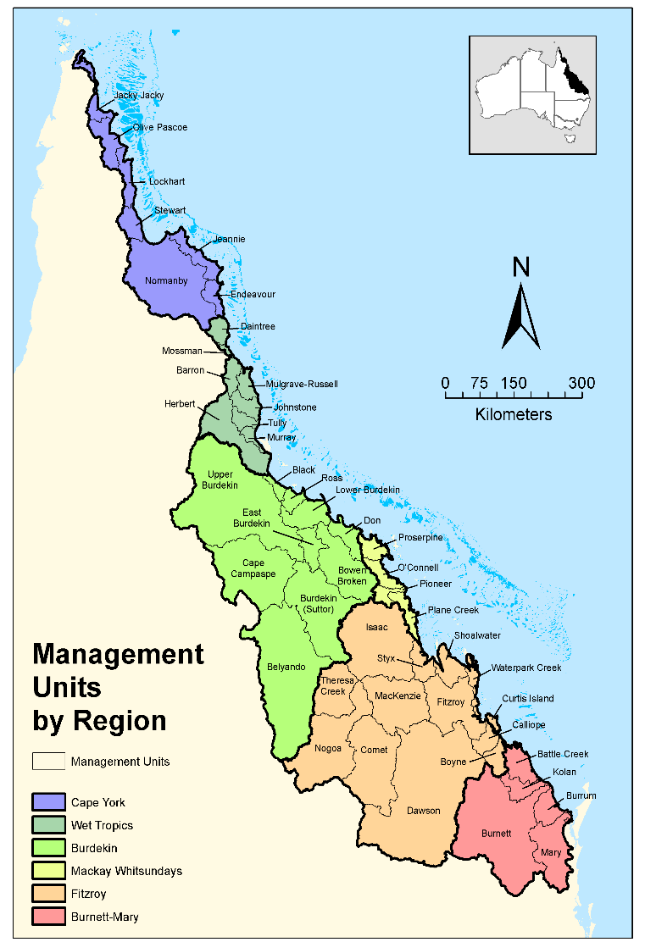
We report at different regional scales
Varies by indicator
GBR-wide
6 NRM regions
+ finer scale down to
35 catchments &
47 Management units, inc. major sub-catchments
Notes:
Due to the vast area of the GBR catchment, we report findings by regions, of which we have 6.
The 6 natural resource management regions can be further divided into:
35 catchments and
47 management units (including major sub-catchments)
This slide was approved by the DDG DESI as part of the Reef Water Quality Report Card 2021 and 2022 Stakeholder pre brief was presented to Reef Stakeholders in late June 2024.

Slide 7
Reef Water Quality Report Card
The Reef Water Quality Report Card is an interactive web-based product - it is not produced as a document.
While previous report cards have mostly been released annually, this report card presents results for two years – 2021 and 2022, showing progress towards Reef Water Quality Improvement Plan targets and objectives to June 2022.
It takes approximately 18 months to prepare a report card from the end of the data period that it is reporting on.
The Report Card uses a standardised five-point scoring system (A-very good, B-good, C-moderate, D-poor, E-very poor) to assess progress towards the water quality and catchment management targets and inshore marine and wetland condition objectives.
Scores for the water quality targets are based on the minimum annual reductions required to achieve the 2025 targets. The cumulative progress since 2009 is also shown for context.
Notes:
Due to the size of the GBR Region, the Reef Water Quality Report Card is produced as an interactive web-based product.
The present Report Card shows progress towards the Reef Water Quality Improvement Plan targets and objectives to June 2022.
It takes approximately 18 months to prepare a report card from the end of the data period that it is reporting on. Modelling alone takes 6 months to complete.
In the next slides, Rob Hunt will give a through a ‘walk-through’ of the interactive report card. I will walk us through what is on Reef water quality report card website.
The Report Card uses a standardised five-point scoring system (A-very good, B-good, C-moderate, D-poor, E-very poor) to assess progress towards the water quality and catchment management targets and inshore marine and wetland condition objectives.
Scores for the water quality targets are based on the minimum annual reductions required to achieve the 2025 targets.
The cumulative progress since 2009 is also shown for context.
This slide was approved by the DDG DESI as part of the Reef Water Quality Report Card 2021 and 2022 Stakeholder pre brief was presented to Reef Stakeholders in late May 2024.

Slide 8
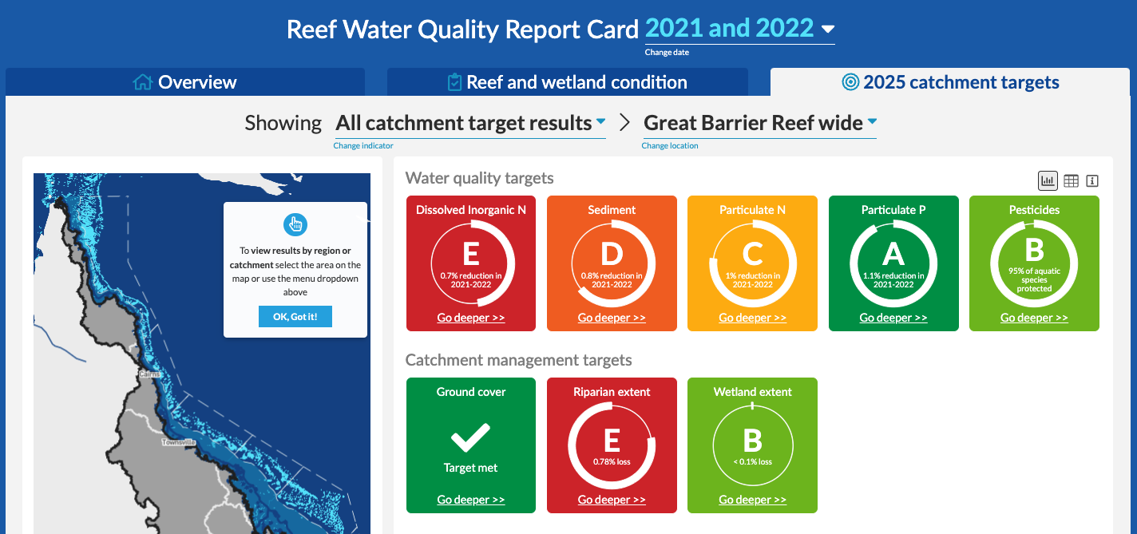
Interactive online Reef Water Quality Report Card
https://www.reefplan.qld.gov.au/tracking-progress/reef-report-card
Notes:
Starting in 2009, there have been 11 report cards
Since 2017, the switch was made to interactive online delivery.
The QR code will help you navigate to it.
These are the 2025 targets – what you see here is exactly what is on the present Report Card. This slide shows where to find the results.
This slide was approved by the DDG DESI as part of the Reef Water Quality Report Card 2021 and 2022 Stakeholder pre brief was presented to Reef Stakeholders in late May 2024.

Slide 9
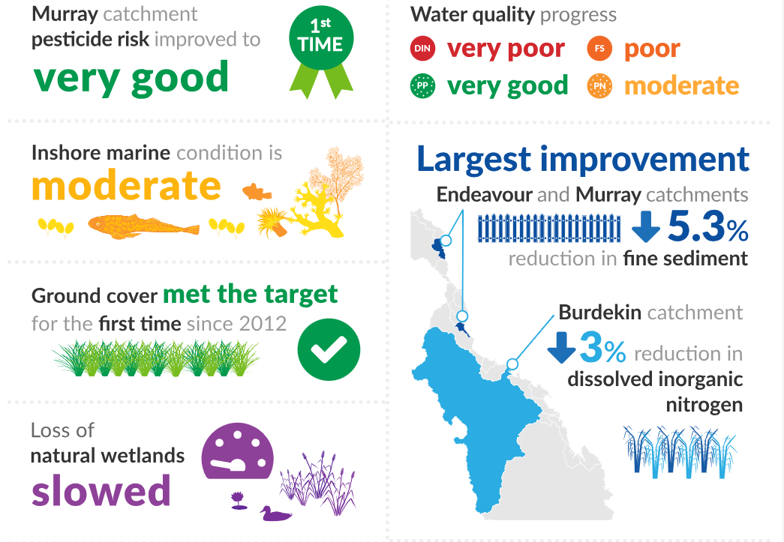
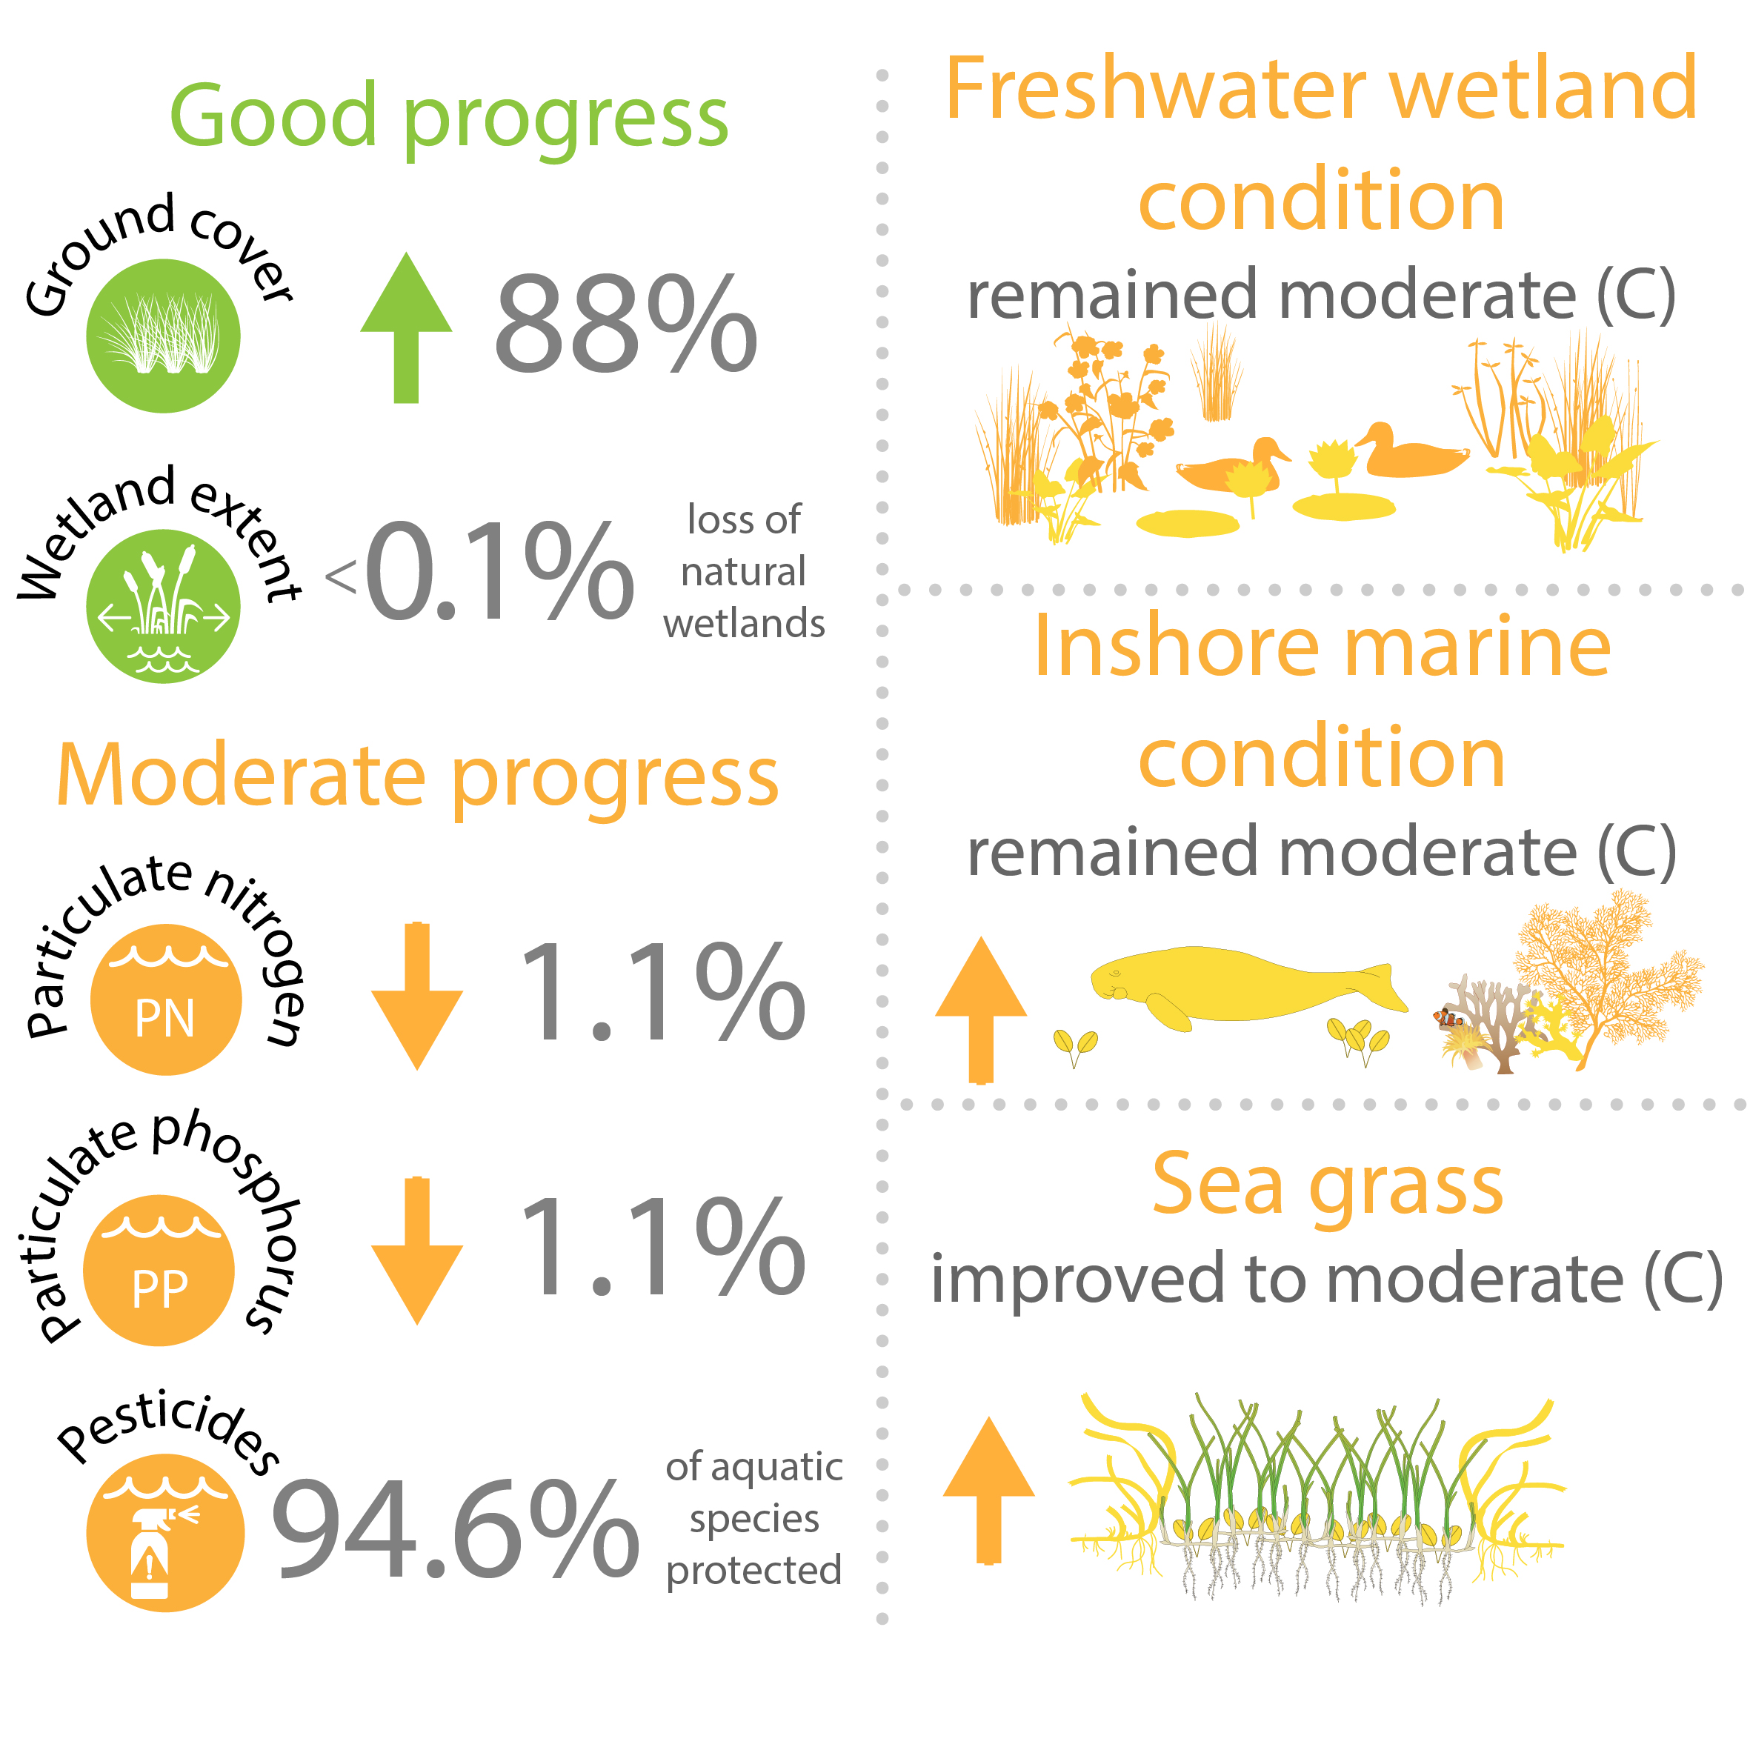
2021 and 2022 Key Results
High-level Key Results
Highlights from the Burdekin Region
Notes:
High level key results
First schematic is across the whole GBR
Burdekin’s interest would need to be emphasized here – it is the schematic on the right
Let them read it and highlight:
Ground cover – we met this target due to high rainfall over the 4-year period.
Wetlands
This slide was approved by the DDG DESI as part of the Reef Water Quality Report Card 2021 and 2022 Stakeholder pre brief was presented to Reef Stakeholders in late May 2024.

Slide 10
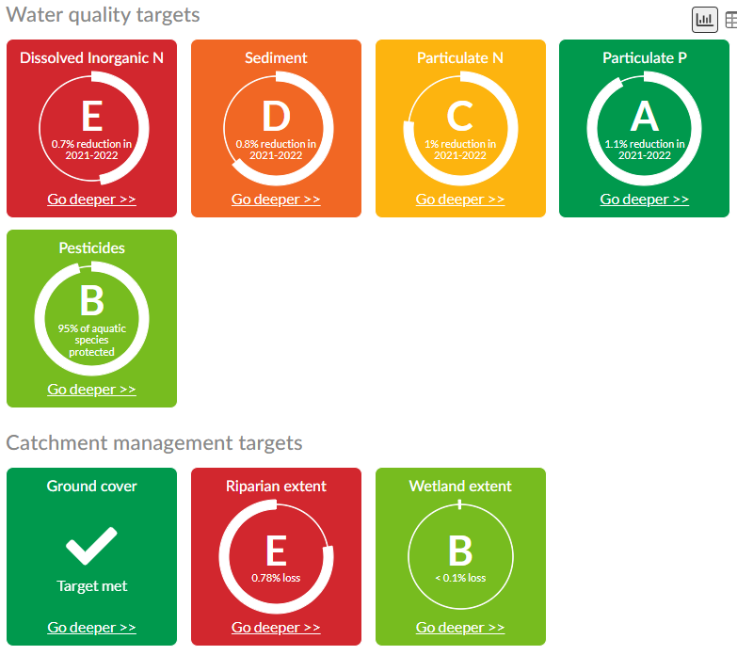
Great Barrier Reef wide results
Notes:
Here, we are talking about the results for the whole of the GBR
We are making good progress in areas like:
Reducing particulate P
Meeting ground cover
Extent of wetlands and
Reducing pesticide use
But more work remains to be done in other areas including:
Dissolved inorganic N
Particulate N
Riparian extent
Sediment discharge
This slide was approved by the DDG DESI as part of the Reef Water Quality Report Card 2021 and 2022 Stakeholder pre brief was presented to Reef Stakeholders in late May 2024.

Slide 11
Multiple scales of reporting - regional report cards
Notes:
Where does the data from the P2R program go? Into the other report cards
Both inshore and whole reef report cards use the same datasets, but report on different things
https://www.reefplan.qld.gov.au/tracking-progress/regional-report-cards

