Slide 1
2021-2022
Reef Report Card
Burdekin Summary
Rob Hunt – Sustainable Agriculture Program Manager
Burdekin Region Water Quality Science Forum
10th of September 2024

Slide 2
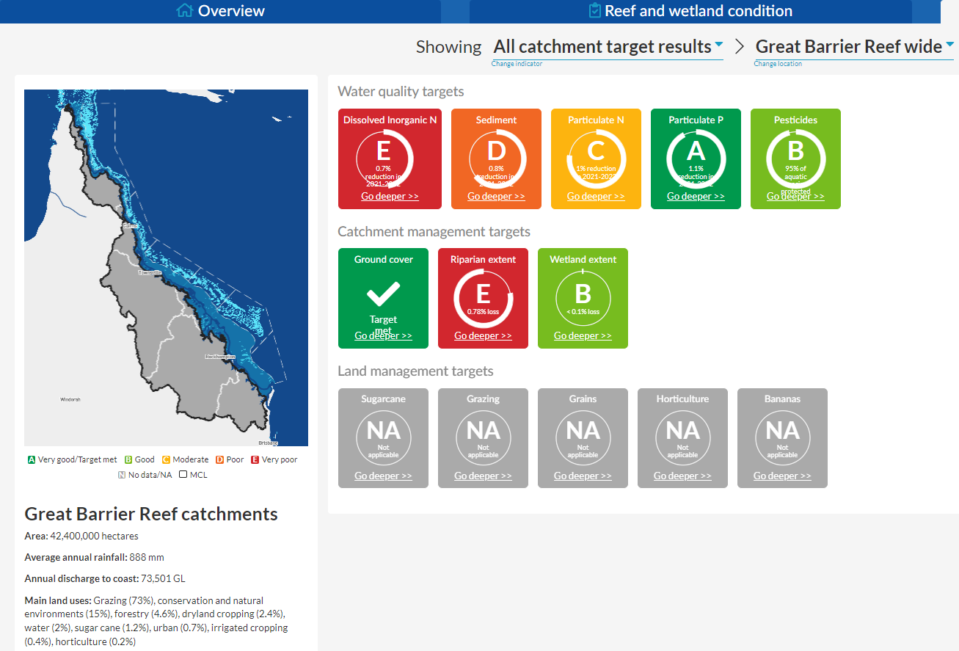
What is a Reef Water Quality Report Card
Progress towards various targets set to protect the health of GBR:
Reef and Wetland condition
Water quality
Catchment management
Land Management
Viewable as:
Individual catchment
Region
Whole of reef catchment
Represents year previous to report card date (~2020-2021)
Reports follow investments
Not a reflection of most recent investments

Slide 3
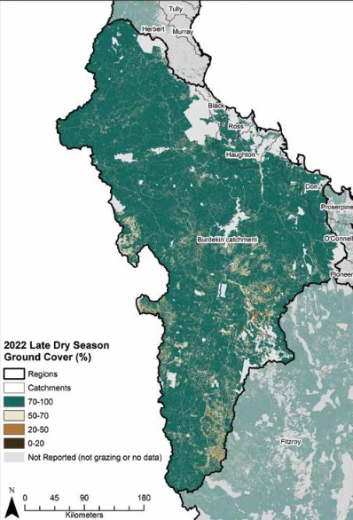
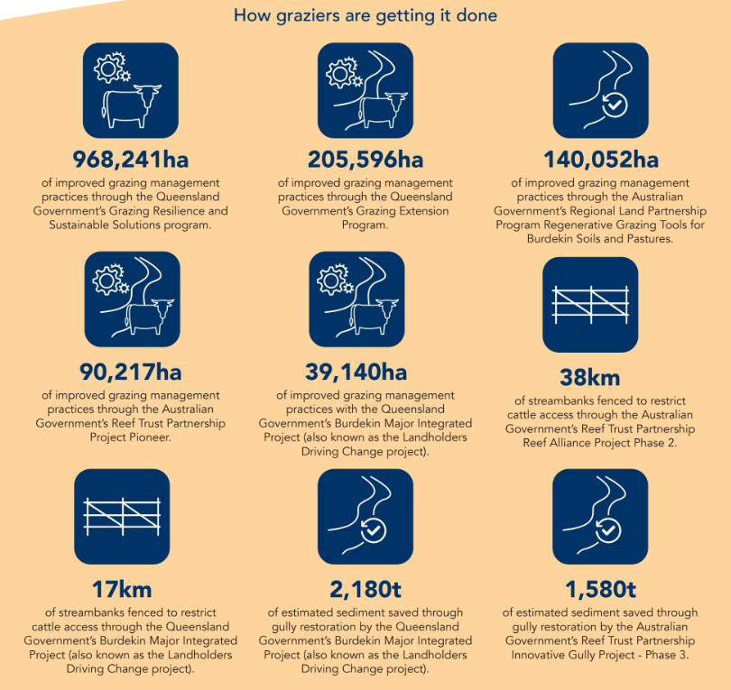
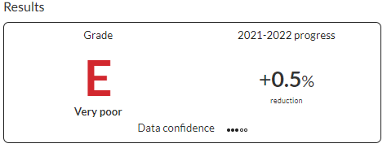
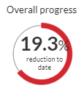
Burdekin Summary - Sediment
Ground cover - Scored 88/90 thanks to good seasons and improving practices
611kt of the 895kt target (68%)
Enormous amount of on-ground activity
?
?

Slide 4
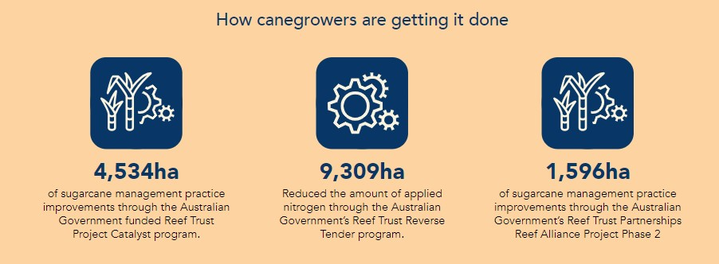
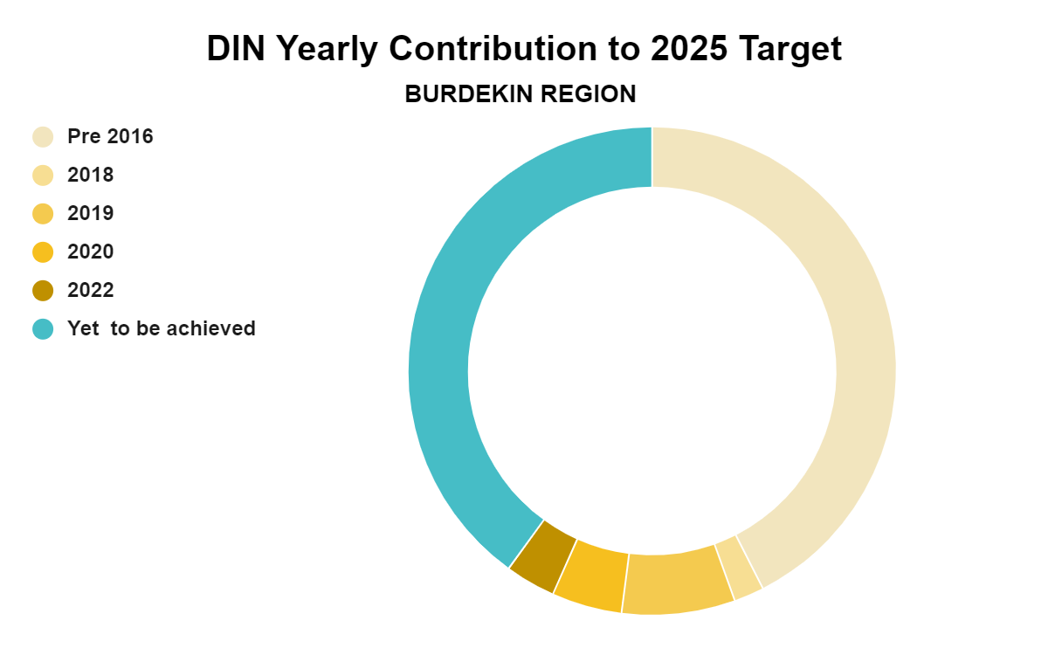
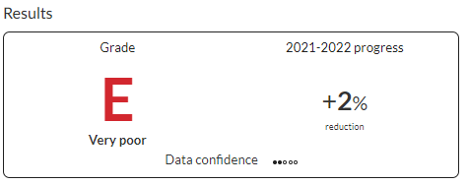
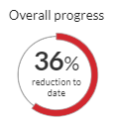
Burdekin Summary - Dissolved Inorganic N
Achieved 444t of the 740t target (60%)
73% achieved in the Haughton
Significant on-ground progress in irrigation nutrient mgt practices that reduce DIN
?
?

Slide 5
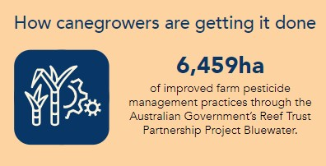
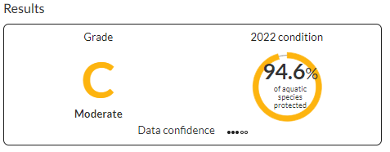
Burdekin Summary - Pesticide
Target is 99% of aquatic species are protected at end of catchment
Monitoring shows:
Haughton currently at 80% protection
Burdekin at 94.6% protection

