Slide 1
Regional Water Quality Strategy
Burdekin Water Quality
Science Forum
10 Sep 2024

Slide 2
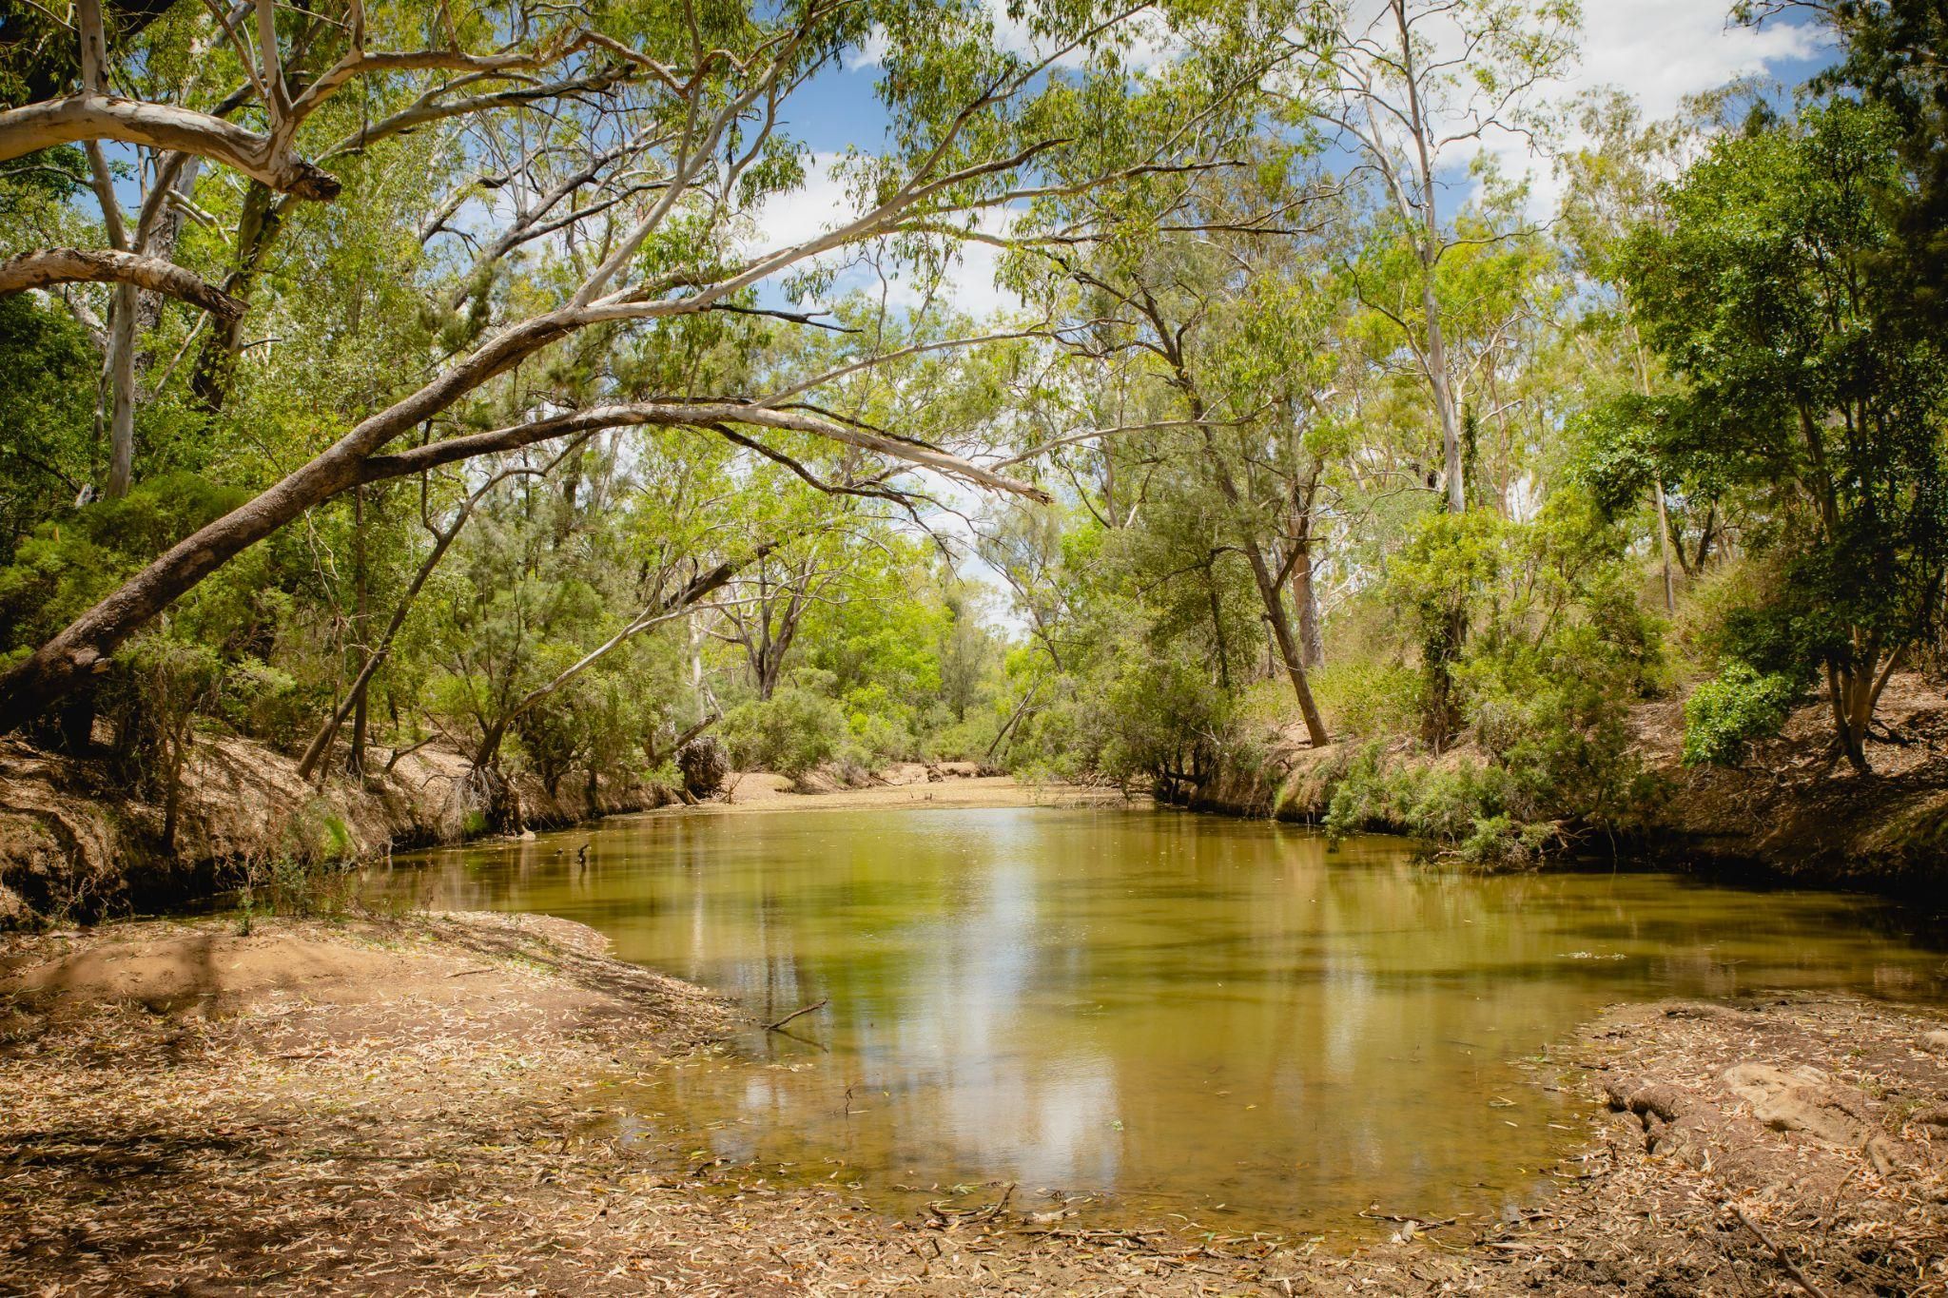
Burdekin Regional Water Quality Strategy
WHY we are developing the Strategy
WHAT is in and out of scope
HOW it will be developed and opportunities to be involved

Slide 3
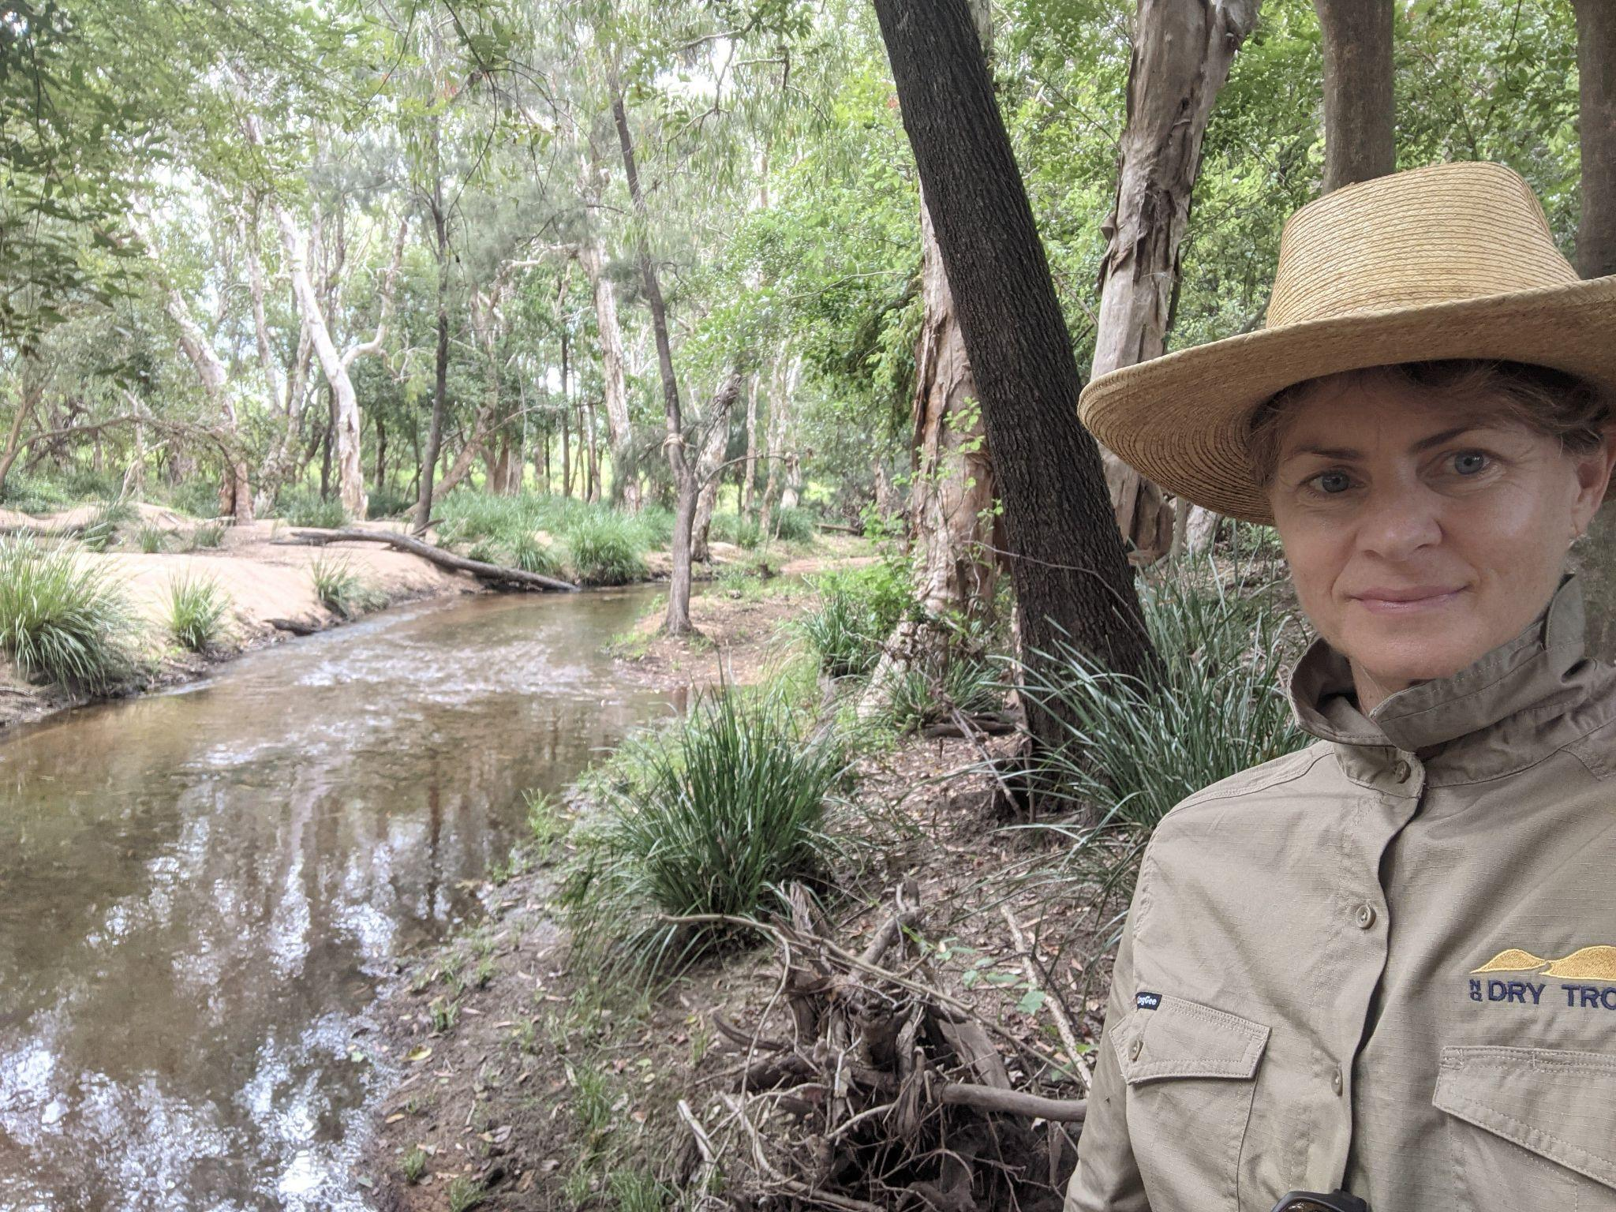
PURPOSE - Regional Water Quality Strategy
Prioritise resources and investment to maximise regional water quality outcomes
Strategic level approach to guide terrestrial water quality management, interventions and improvement
Region’s strategy - support regional organisations, stakeholders and potential investors to reduce terrestrial impacts
Will not commit government to investment in Strategy’s actions
Investors/funding bodies will look for alignment with the Strategy when assessing regional water quality program and project proposals

Slide 4
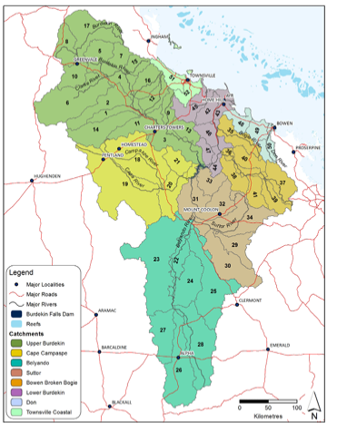
WHAT - Regional Water Quality Strategy
IN SCOPE
Alignment to Reef 2050 LTS outcomes; 2050 WQIP targets & objectives
Regional shared vision and high level goals
Priority locations and priority areas relating to terrestrial impacts
Focus on regional capacity & capability -
Identify knowledge gaps for future investment

Slide 5
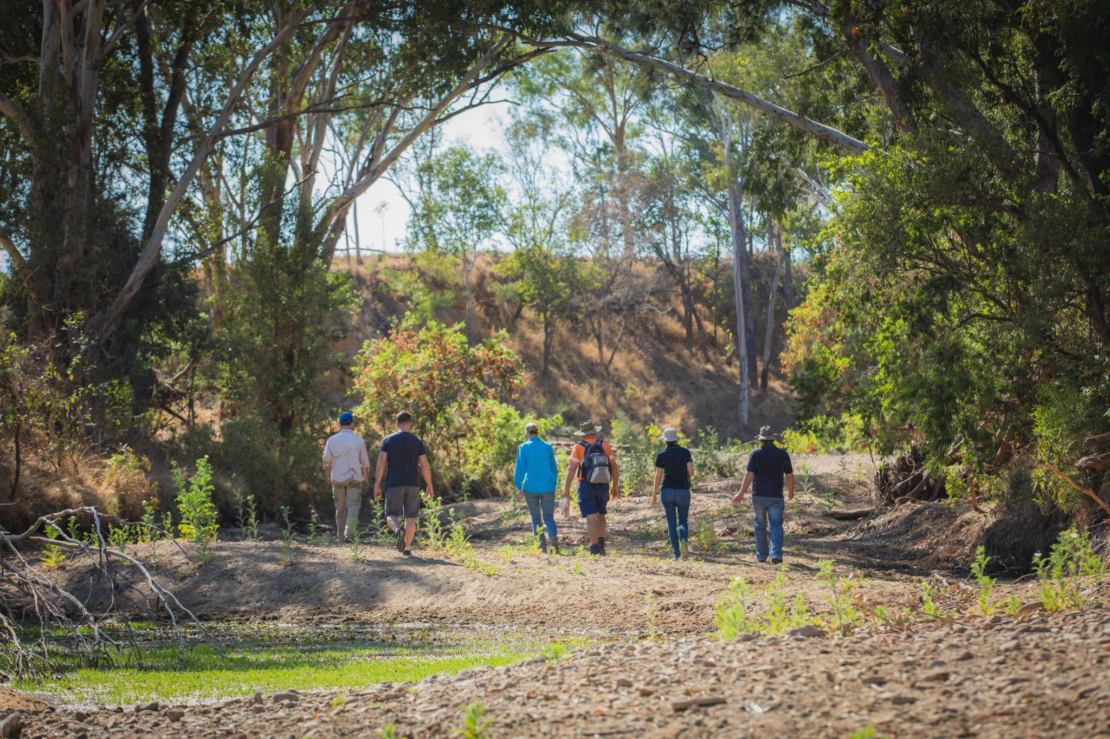
WHAT - Regional Water Quality Strategy
OUT OF SCOPE
Targets & objectives
Investment costings
Non water quality regional priorities

Slide 6
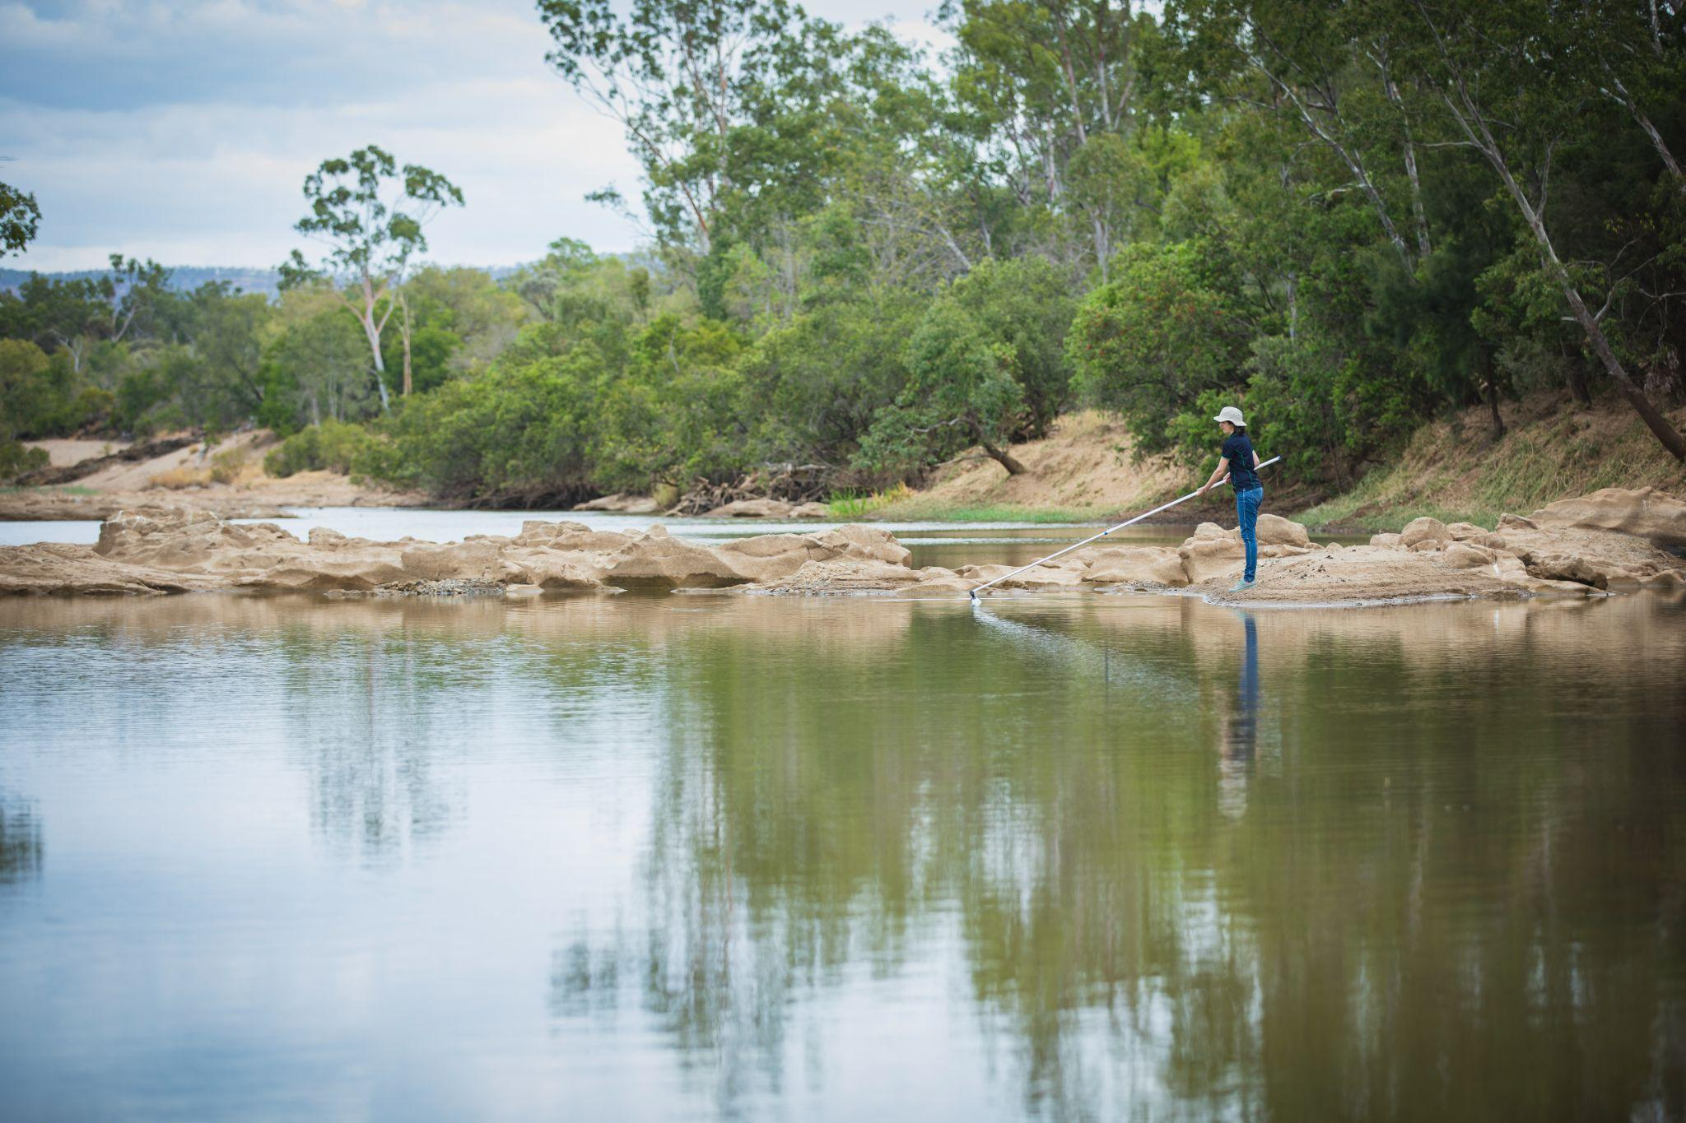
HOW - Regional Water Quality Strategy
Strong linkages & alignment
Reef 2050 Long-term Sustainability Plan
Reef 2050 Water Quality Improvement Plan
Reef 2050 Wetland Strategy
Reef 2050 Traditional Owner Implementation Plan
2022 Scientific Consensus Statement
Burdekin Dry Tropics NRM Plan
BDT Traditional Owner Caring for Country Plan
Burdekin Regional Water Quality Improvement Plan 2016
Burdekin Region Water Quality Report Card
Healthy Waterways & Rivers to Reef partnerships report cards
Six regional reef catchment strategies

Slide 7
Planning linkages
WATER QUALITY PLANNING
REGIONAL NRM PLANNING
External Strategies
&
Policies
Eg BRWP, BRWA
Reef 2050 Long-term Sustainability Plan
Burdekin Dry Tropics Regional NRM Plan
Caring for Country Plan
Reef 2050 Traditional Owner Implementation Plan
Reef 2050 Water Quality Improvement Plan
Pest Management Strategy
Reef 2050 Wetland Strategy
Others
eg. Disaster Prepare & Recovery Plan
Regional Water Quality Strategy
Themes across all areas - Traditional Owner engagement, Environmental markets etc…
Regional WQIP 2016
Sediment
(Landscape Remediation)
DIN & Pesticides (Cropping)
Non- agri pollutants (Urban)
Degradation of riverine & coastal ecosystems
Climate Change, Other
Regional Reef Report Cards
2022 Scientific Consensus Statement

Slide 8
Strategy development - your involvement
Stage one
AUG - DEC 2024
JAN - MAR
2025
APR - JUN
2025
Desktop research & consultation - Science forum, Traditional Owners & targeted
Baseline Report
Stage 1 SEP - DEC 2024
Stage two
Draft Strategy
Targeted consultation
Region wide consultation
Stage three
Final Strategy
Targeted consultation
Final Draft Strategy

