Slide 1
2022 Scientific Consensus Statement
Land-based impacts on Great Barrier Reef water quality and ecosystem condition

Slide 2
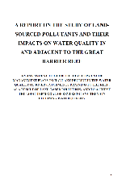
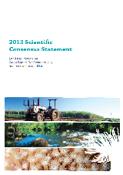
What is the Scientific Consensus Statement?
The Scientific Consensus Statement (SCS) brings together peer reviewed scientific evidence on how land-based activities can impact water quality on the Great Barrier Reef.
It helps to create a common understanding about Reef water quality and ecosystem condition.
The 2022 SCS typically includes evidence from 1990 to end of 2022.
It presents the evidence based on the science and does not make recommendations.
Others can then use the evidence to inform their work (e.g. policy, management, agricultural industry, conservation organisations).
Updated regularly to ensure Reef policy remains up-to-date and based on best available evidence
2013 SCS
2008 SCS
2003
2008
2013
2017
2022
Notes:
5th SCS – by far the biggest and most comprehensive for GBR but also internationally

Slide 3
It is one of several sources that provides supporting information for the design, delivery and implementation of the Australian and Queensland government’s Reef 2050 Water Quality Improvement Plan.
Scientific Consensus Statement
Management practice adoption targets
Engagement with other audiences
Review of Water Quality Targets
Notes:
Setting the scene and placing in context
Engagement with other audiences – will hear more about that this afternoon

Slide 4
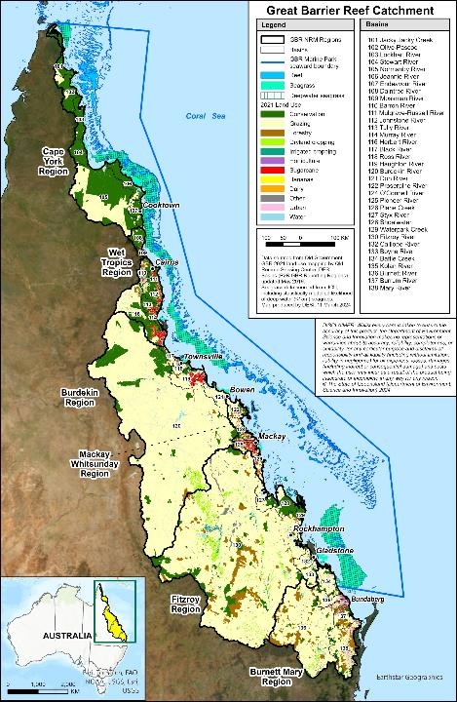
Scope of the 2022 Scientific Consensus Statement
The Great Barrier Reef spans 348,700 km² and encompasses multiple ecosystems across terrestrial and aquatic landscapes - regional variability.
Geographic scope - Great Barrier Reef World Heritage Area and adjacent catchment area including 35 basins.
Highly connected system - the movement of water, matter and organisms is critical for many ecosystems from the catchment and floodplains to the outer reef.
Wide range of ecosystems - marine (coral, seagrass, pelagic, benthic and plankton communities), estuarine (mangroves, saltmarshes) and freshwater (wetlands, floodplain wetlands) ecosystems.
Notes:
Note distance between coast and reef from north to south, most seagrass inshore

Slide 5
Scope of the 2022 Scientific Consensus Statement
Land uses in the Great Barrier Reef catchment area
Other (conservation, forestry)
Irrigated and
dryland cropping
Horticulture and bananas
Grazing
Sugarcane
Urban
The land uses considered were those where human activity (anthropogenic) can alter the landscape, specifically grazing, sugarcane, dryland and irrigated cropping, bananas, other horticulture, and urban.
The primary pollutants considered were nutrients, sediments, pesticides and other pollutants (metals, persistent organic pollutants, per- and poly-fluoroalkyl substances, plastics, pharmaceutical, veterinary and personal health care products, and coal dust).

Slide 6
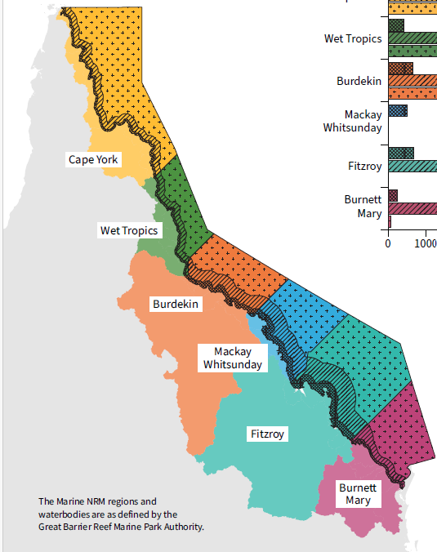
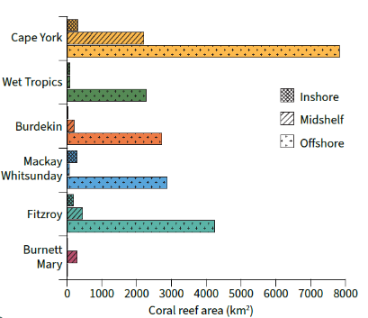
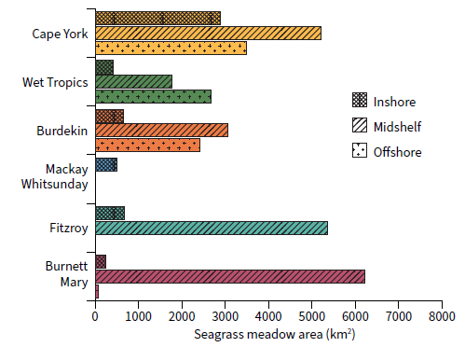
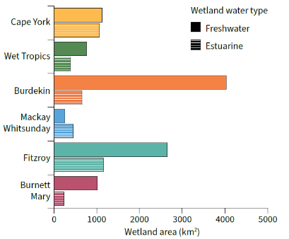
*
*
Seagrass
Coral reef
*
Wetlands
Notes:
Ecosystems of the NQDT

Slide 7
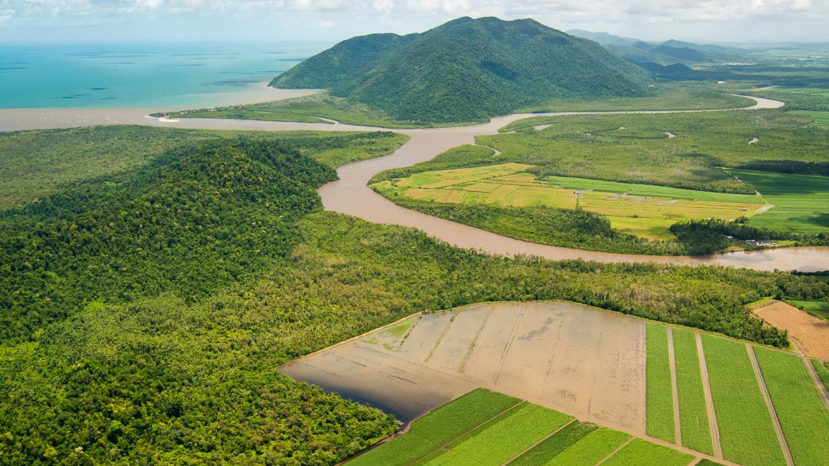
2022 SCS Process
© Dieter Tracey

Slide 8
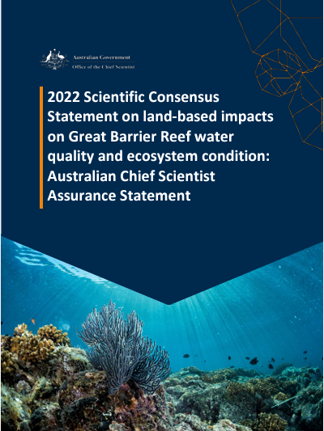
Major changes
Australian and Queensland governments appointed C₂O Consulting to independently lead the design, development and delivery of the 2022 SCS bringing in experts to support different steps of the process.
Developed using fit for purpose international best practice for evidence synthesis, peer review and consensus methods.
Oversight and assurance provided by Australia’s Chief Scientist.
Deliberately designed to deliver a trusted, rigorous and credible report underpinned by high-quality science.
Opportunity for stakeholders to have input to the questions and kept informed of process throughout.
Notes:
Continuous improvement in approach
Undertook consultation about how process can be improved
Thanks to Rachael Smith major influence in approach

Slide 9
Major changes
Australian and Queensland governments appointed C₂O Consulting to independently lead the design, development and delivery of the 2022 SCS bringing in experts to support different steps of the process.
Developed using fit for purpose international best practice for evidence synthesis, peer review and consensus methods.
Oversight and assurance provided by Australia’s Chief Scientist.
Deliberately designed to deliver a trusted, rigorous and credible report underpinned by high-quality science.
Opportunity for stakeholders to have input to the questions and kept informed of process throughout.
A set of guiding principles have informed all aspects of the project.
Notes:
Continuous improvement in approach
Undertook consultation about how process can be improved
Thanks to Rachael Smith major influence in approach

Slide 10
Major steps in the development of the 2022 SCS*
4. Peer review process
1. Question setting
Three primary outputs of the 2022 SCS
2. Author selection
Synthesis of evidence
Summary
Conclusions
3. Synthesis of evidence methods development
5. Consensus process
* The process for all major steps has been recorded in a series of ‘Approach’ documents. These are available on the 2022 SCS website.
Australia’s Chief Scientist provided oversight of process development to ensure approaches were best practice, credible and robust
Notes:
All steps thoroughly documented in Approach documents.
Dr Foley has considered these in her assessment of the process.

Slide 11
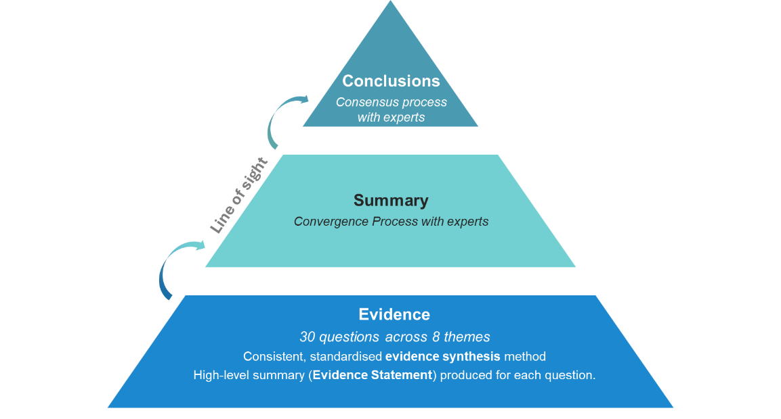
Structure of the 2022 SCS
Notes:
Major outputs

Slide 12
Background Themes
Themes
Cross-cutting themes
Ecological, cultural & socioeconomic asset values and condition of the Great Barrier Reef
3
Sediments and particulate nutrients
Ecological processes
What is the ecological condition, process or function being disturbed by the pollutant and how?
Delivery and source
What processes are responsible for the transport of excess pollutants?
What are the sources of the pollutant and how much is anthropogenic?
Management options
What causes of anthropogenic pollutants can be managed?
How can management responses reduce the pollutant?
Which management responses are most effective?
1
4
Dissolved nutrients
2
The context and extent of water quality threats
5
Pesticides
6
Other pollutants
7
Human dimensions of water quality improvement
8
Future directions and emerging science
Notes:
The SCS is broken up into eight themes containing 30 questions in total. For the main pollutants…
Mention scope – GBR and its catchments
Remembering that reference to GBR ecosystems includes wetlands, coastal and marine ecosystems - and a whole range of ecosystems and species within those areas

Slide 13
Synthesising the evidence
International best practice approaches for evidence synthesis
Developed by an independent evidence synthesis expert to ensure fit for purpose
Transparent and repeatable method
Standard template to enable consistency
Structured literature searches using publicly available peer reviewed material only
Potential for bias minimised in the review and appraisal of the evidence
Evaluated the relevance of the evidence to the GBR at spatial and temporal scales
Assessed and presented a level of ‘confidence’ in the evidence
Typically between 1990 and end of 2022
Guided by an expert Methods Working Group
Confidence rating
High
Moderate
Limited
Notes:
Reminder of the key features of the method – very systematic approach, specifically designed for GBR drawing on international approaches for informing evidence-based policy.
Each question undertook evidence appraisal of every study– captured in Data Extraction Sheet
Introduced assessment of confidence to give an indication of where strong foundational evidence, where there are still areas of uncertainty, and emerging knowledge

Slide 14
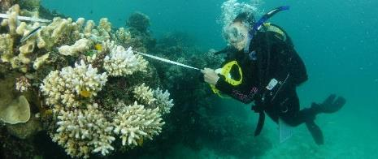
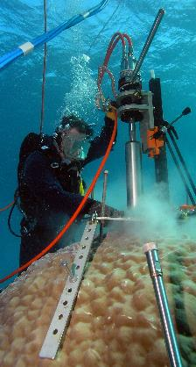
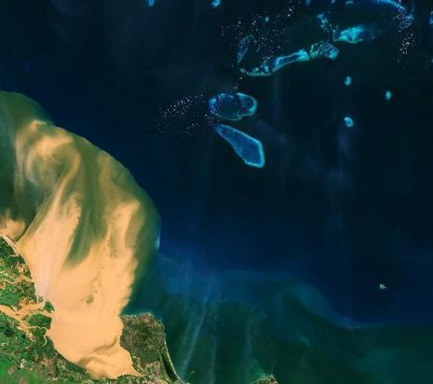
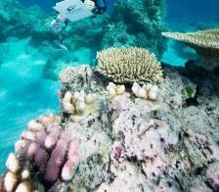
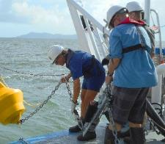
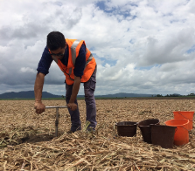
Multiple lines of evidence
Similar findings from studies that use a range of methods (e.g. modelling, experimental, observational) can give confidence in the findings.
Notes:
Look for multiple lines of evidence either in relation to a particular hypothesis or whether different methods are providing consistency in results/findings.
This helps to provide a degree of confidence in the findings and can illustrate where more information might be needed to fully understand a process, an impact or type of management…

Slide 15
Peer review process
Independent Editorial Board
Established to design and manage peer review process
1 Editor-in-Chief and 6 highly experienced Editors
Approach
Based on indexed scientific journals
More thorough and consistent with structured review form including questions around bias, rigour and quality
63 Reviewers for Questions
Appointed following Conflict of Interest assessment
2 Reviewers for 27 questions
3 Reviewers for 3 questions (Q3.6, 4.3, 4.7)
Accept
Minor revisions
Major revisions
3 Eminent Reviewers Conclusions & Summary
Appointed by Australia’s Chief Scientist and Editor in Chief following Conflict of Interest assessment
Agriculture, marine, catchment expertise
50% Great Barrier Reef
50% Australia and beyond
Notes:
Very comprehensive process – similar to scientific journals but even more thorough and consistent with structured review form to target specific aspects – including evidence of author bias

Slide 16
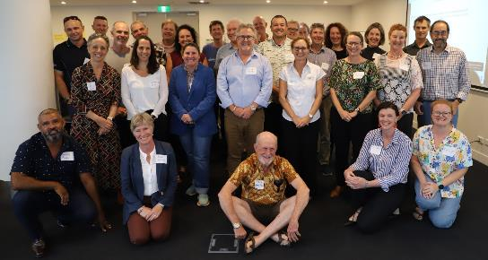
Producing the 2022 SCS Conclusions and Summary
Summary
Conclusions
Peer reviewed syntheses of evidence
Drafting team + Theme expert groups
Drafting team + 35 experts
Convergence process using a ‘Single-Draft Text Procedure’. Drafting team sought input and advice from expert groups across three rounds to produce Theme Summary Statements.
Expert elicitation process, consensus workshop, and final input and acceptance by all experts involved in the preparation of the Concluding Statements.
Guided by an expert Consensus Process Working Group
Experts at the Consensus Workshop
Notes:
Involved 35 experts – all lead authors plus some additional contributors.
5 combined groups, 7-9 experts each.
Our team drafted, experts reviewed and adjusted. Oversight by independent expert from Working Group.

Slide 17
SCS Coordination Team (C₂O Consulting)
Stakeholders consulted on question setting
1
>70
28
Individuals submitted 229 items of literature for consideration
Australia’s Chief Scientist
1
Headline numbers of the 2022 Scientific Consensus Statement
78
69
Authors and contributors
Peer reviewers
2
1
Expert working groups (Methods and Consensus)
Independent Editorial Board (1 Editor-in-Chief, 6 Editors)
3
5
Evidence synthesis experts
Stakeholder groups and expert committees (IEP, ISP, RAC)
Notes:
Overall, very comprehensive process involving over 200 experts in several roles.

Slide 18
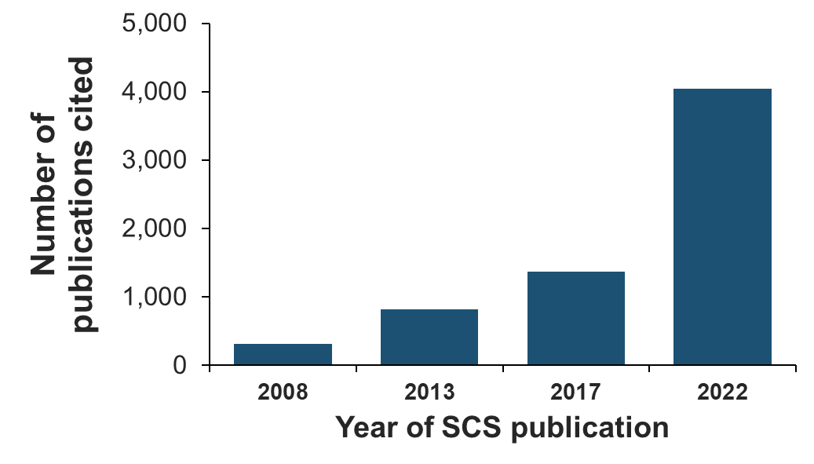
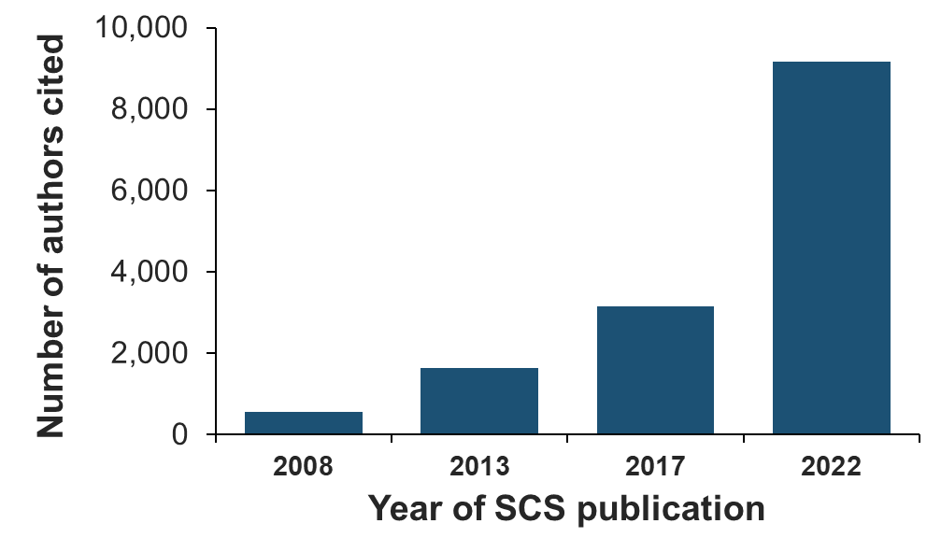
Headline numbers
4,040 publications formed the evidence base of the 2022 Scientific Consensus Statement. 440 publications were used in more than one question.
9,156 authors were cited in the 2022 Scientific Consensus Statement
Bibliometrics analysis by Tace Stewart, QUT
Notes:
Bibliometrics analysis undertaken by QUT going through the last SCSs
2017 – 1373 items – more than doubled
2017 - 3151 authors - tripled

Slide 19
Notes:
Conclusions are the points that came up several times across the evidence base
Recognise variability across GBR over space and time

Slide 20
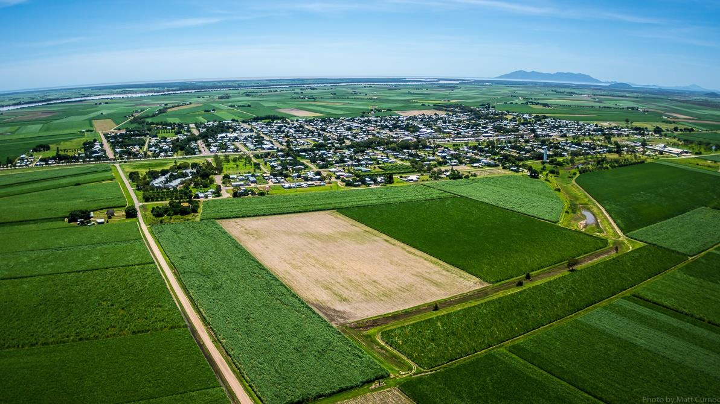
1
Historical and continuing land management and catchment modification impair Great Barrier Reef water quality through extensive vegetation degradation, changed hydrology, increased erosion, and expansion of fertilised land uses, urban centres and coastal developments.
© Matt Curnock
Notes:
Recognising major changes in the catchment that have lead to changes to WQ in the GBR

Slide 21
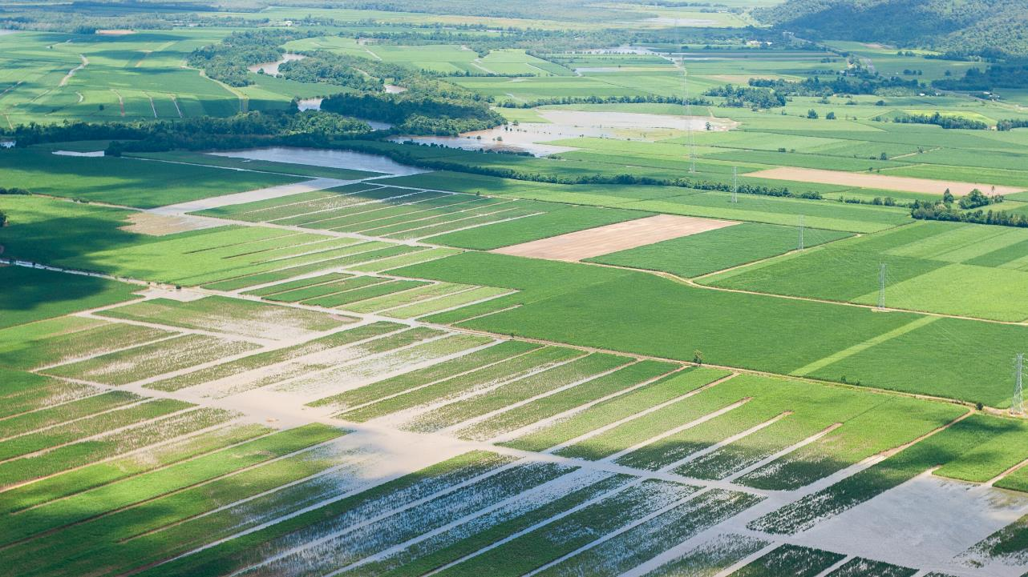
2
Pollutant loads from the catchment area to the Great Barrier Reef have increased from pre-development loads by 1.4 to 5 times for fine sediments, and 1.5 to 3 times for dissolved inorganic nitrogen (with variations depending on basins).
© Dieter Tracey
Notes:
Evidence about the influence of these changes on pollutant loads

Slide 22
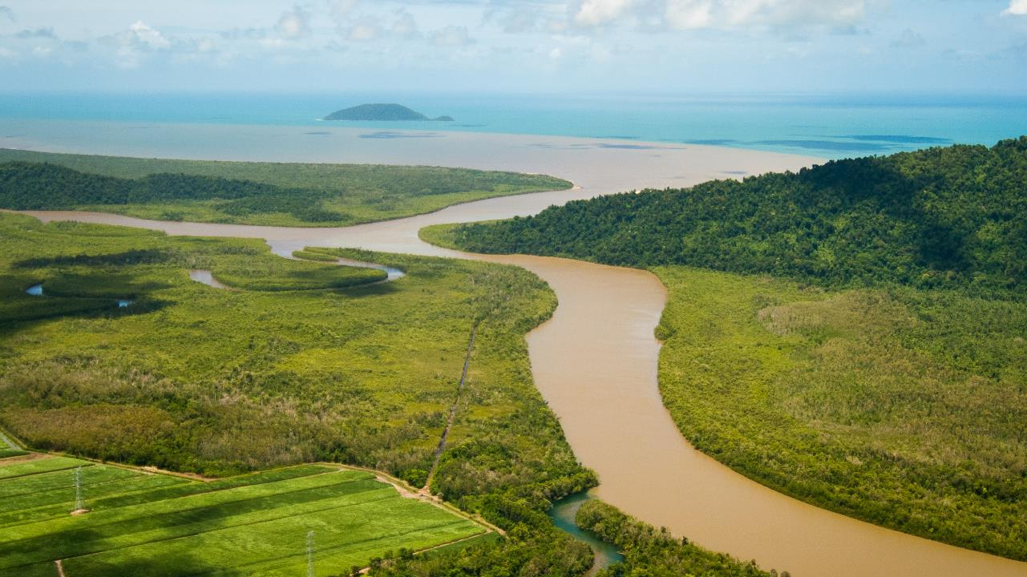
3
Poor water quality, particularly elevated levels of fine sediments, nutrients and pesticides, continues to have detrimental impacts on Great Barrier Reef ecosystems. The greatest impacts are on freshwater, estuarine, coastal and inshore marine ecosystems.
© Dieter Tracey
Notes:
Recognising the impacts of poor WQ on the GBR – and really talking about freshwater to inshore areas
Regional variability – northern GBR closer to coast, southern GBR broader reef matrix further offshore but coastal ecosystems important including seagrass

Slide 23
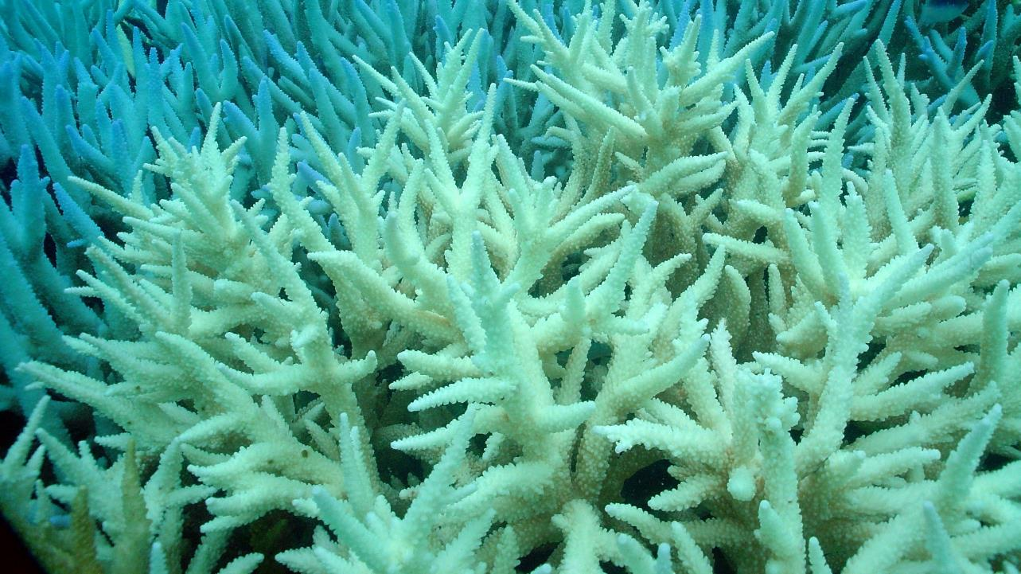
4
Human-induced climate change is the primary threat to the Great Barrier Reef and poor water quality can exacerbate climate-related impacts. Good water quality is critical for healthy and resilient ecosystems and supports recovery from disturbances such as mass bleaching and extreme weather events. Meeting water quality improvement targets within the next ten years is imperative.
The 2025 targets defined in the Reef 2050 Water Quality Improvement Plan [currently under review] require a 25% reduction in the 2009 anthropogenic end-of-catchment fine sediment loads, 20% reduction of particulate nutrients, and a 60% reduction of dissolved inorganic nitrogen loads. The target for pesticides is to protect at least 99% of aquatic species at end-of-catchments by 2025.
Notes:
Putting WQ in the context of other drivers, and interaction with climate change. Role of good water quality in supporting recovery from disturbances.
Emphasising need to meet WQ targets within 10 years

Slide 24
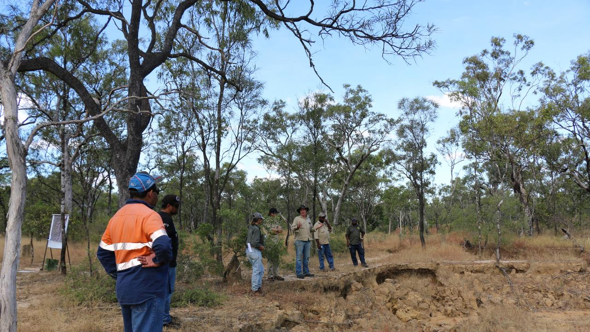
5
While several land management practices and remediation actions are proven to be cost-effective in improving water quality, translating these into more substantial pollutant reductions will require significant scaling up of the adoption of these actions, prioritisation of pollutant hotspots, and greater knowledge of the costs and potential co-benefits of practice adoption.
Notes:
Management side of things – emphasising that while we have good evidence for a range of practices, these need to be scaled up, targeted to hotspots and supported by better knowledge of costs and potential co-benefits

Slide 25
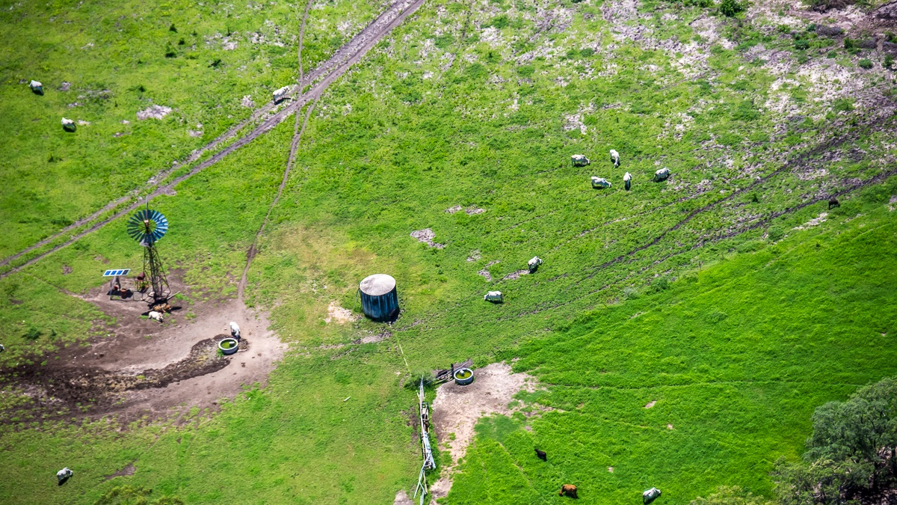
6
Greater focus on locally effective management solutions can encourage faster adoption, especially when designed and delivered using collaborative approaches involving landholders, Indigenous communities, the broader community, policy makers and scientists.
© Matt Curnock
Notes:
About the importance of local scale actions (and what they are), collaborative design and delivery approaches

Slide 26
World-leading monitoring, modelling and reporting programs underpin the Great Barrier Reef ecosystems and provide essential knowledge to inform water quality improvement strategies. These programs could be strengthened and refined by increasing their spatial and temporal coverage to capture regional and local differences, provide more balanced coverage across land uses and ecosystems, improve trend analysis and quantify uncertainties.
7
Notes:
GBR has world-leading M&E programs that are necessary to inform strategies – P2R, MMP, RIMREP, identified a range of areas where could be strengthened in terms of coverage, scale, land uses, ecosystems. Trend analysis becoming relevant with longer-term programs now in place. Need to quantify uncertainties.

Slide 27
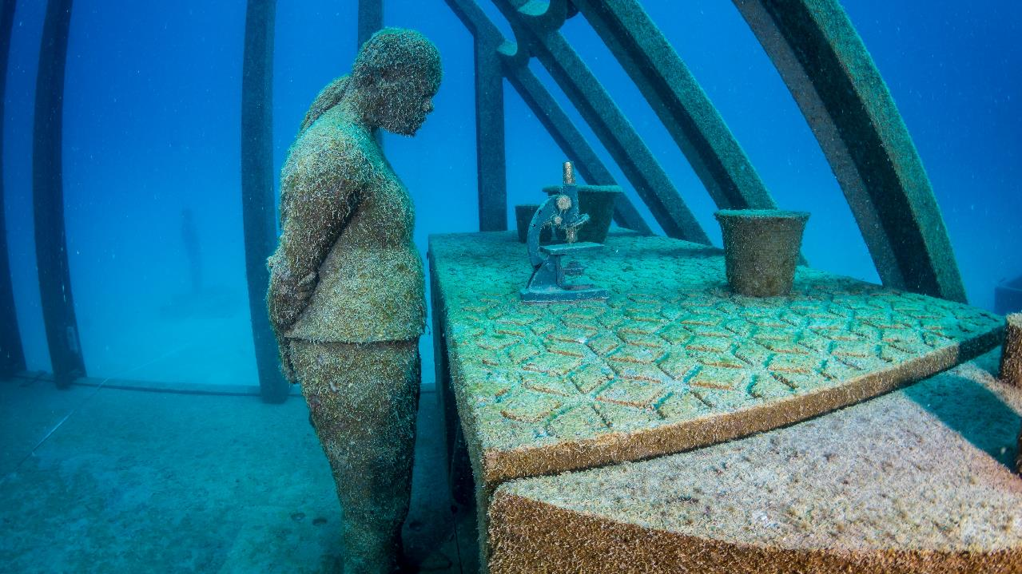
© Matt Curnock
8
Expanded research effort and more consistent methods are urgently needed to adequately assess 1) the co-benefits and efficiency (including costs) of management solutions across different landscape and climate conditions, 2) the effectiveness of water quality improvement programs and instruments including assessment beyond the life of programs, and 3) ecosystem risks from a wider range of pollutants.
Notes:
Some of the key gaps that kept coming up across questions and are needed to optimise investment outcomes – but also issue of inconsistent methods kept coming up. Co-benefits and cost-effectiveness in more situations, program evaluation and legacies, risks from pollutants including other pollutants like trace metals, microplastics

Slide 28
Strength of evidence
Confidence - Quantity - Diversity
4,480 studies
High | Value and connectivity of GBR ecosystems Spatial and temporal distribution of sediments, nutrients and pesticides Drivers and sources Impacts on some GBR ecosystems with some exceptions such as wetlands, other pollutants
Moderate | Effectiveness of management practices – limited information on certain land uses (e.g. bananas/horticulture, urban, and roads) Certain management practices in the GBR context (e.g., streambank rehabilitation, wetland treatment systems)
Limited to Moderate | Effectiveness of programs and instruments aimed at management practice adoption Factors influencing adoption of practices that improve water quality - limited published and peer reviewed information
Lowest | ‘Other pollutants’ (such as per- and poly-fluoroalkyl substances, pharmaceutical, veterinary, and personal health care products, coal dust and fly ash, and sunscreen) - limited local evidence on many pollutant types, especially ecological risk Factors of success in Indigenous involvement in water quality management and decision making

Slide 29
Recent findings since the 2017 Scientific Consensus Statement
Improved knowledge
Role of water quality in context of climate change
Water quality and crown-of-thorns-starfish outbreaks
Distribution and impacts of pesticide mixtures
Hotspots for pesticide management
Other pollutants
Enhanced Efficiency Fertiliser application in sugarcane
Reinforced findings
Loads well above pre-development rates
Contributions from land uses
Biophysical drivers
Some management practices
Recent findings
New knowledge
Effectiveness of large-scale gully remediation
Role of particulate nutrients
New findings on human dimensions
Greater emphasis on social values
Importance of landholder trust in government, scientists and program delivery organisations to support management practice change
Greater collaboration in design and delivery at local scales
Emerging research
Effectiveness of wetland treatment systems for water quality improvement
Notes:
Reinforced, improved, new, emerging

Slide 30
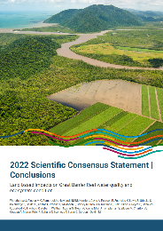
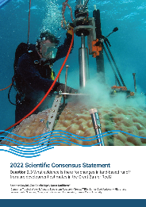
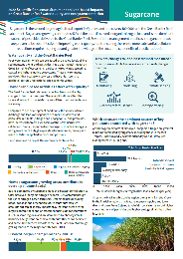
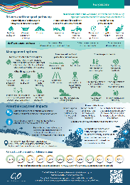
Outputs
Conclusions
Overarching Conclusions
Theme ‘Headline statement’ followed by Concluding Statements.
Summary
Presented by Themes: Summary Statement, Question summary, strength of evidence, recent findings, uncertainties, knowledge gaps.
Questions
Evidence Statement
Evidence Appraisal: Relevance, consistency, quantity, quality.
Key findings, conclusions, uncertainties, limitations, new findings, gaps, contextual drivers, Traditional Owner contributions to evidence base.
FAQs, Topic Summaries, Website

Slide 31
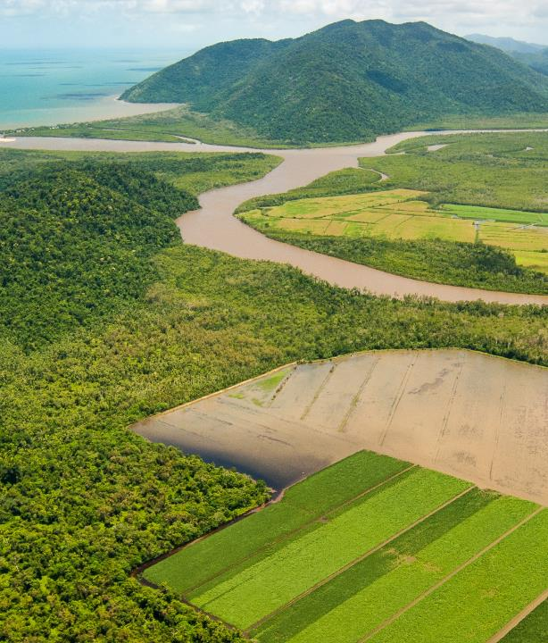
Final remarks
The 2022 Scientific Consensus Statement does not make recommendations for policy and management.
It is critical that any policy or management decisions are based on consideration of the full synthesis of evidence and take into account the evidence appraisal.
Dealing with a very large and highly variable system (land use, climate, habitats, threats) - need to be treated as separate entities to make the most effective decisions to support and protect GBR ecosystems.
Huge resource - information has been gathered and appraised for many aspects – e.g. relevance, consistency, quantity, quality, Traditional Owner contributions to evidence base, uncertainties, limitations, new findings, gaps.
© Dieter Tracey
The 2022 SCS was jointly funded by DCCEEW and DESI and independently led by C₂O Consulting.

Slide 32
Acknowledgements
C₂O Consulting recognises and thanks all the people who have supported the development and delivery of the 2022 Scientific Consensus Statement from authors to expert working groups, reviewers, advisory committees, Contract Managers and Australia’s Chief Scientist.
Aaron Davis
Aaron Hawdon
Abbie Rogers
Adam Smith
Aimee Brown
Al Songcuan
Alana Grech
Alison Theobald
Alistar Robertson
Allan Dale
Amanda Reichelt-Brushett
Amelia Wenger
Andrew Ash
Andrew Brooks
Andrew Hughes
Andrew Negri
Angela Arthington
Angus Thompson
Anne-Laurence Bibost
Anthea Coggan
Anthony Boxshall
Anthony Chariton
Barbara Robson
Ben Preston
Beth Fulton
Bianca Molinari
Bill Venables
Bob Pressey
Bradley Moggridge
Brandon Goeller
Britta Schaffelke
Bronwyn Harch
Bruce Murray
Bruce Taylor
Caleb Connolly
Cameron Holley
Carl Mitchell
Carla Wegscheidl
Catalina Reyes-Nivia
Catherine Collier
Catherine Lovelock
Catherine Neelamraju
Cathy Foley
Christian Roth
Ciemon F Caballes
Claudia Baldwin
Colin Brown
Conway Burns
Craig Johnson
Craig Thornton
Damien Burrows
Daniel Druckman
Daren Harmel
Darren Koppel
David Obura
Dayanthi Nugegoda
Diane Jarvis
Elaine Stone
Elizabeth Dinsdale
Ella Schirru
Eva Abal
Fernanda Adame
Francois Galgani
Geoff MacFarlane
Gillian McCloskey
Graeme Batley
Graham Bonnett
Grechel Taucare
Greg Oliver
Guillermo Diaz-Pulido
Hayley Kaminski
Helene Marsh
Hugh Possingham
Hugh Yorkston
Iain Gordon
Ian Chubb
Ian Prosser
James Smart
James Daley
Jan McDonald
Jane Waterhouse
Jeff Connor
Jenny Stauber
Jessica Hoey
Jianyin (Leslie) Huang
Jim Binney
Joanne Burton
Jochen Mueller
Johanna Johnson
John Bruno
John Cook
John Quiggin
John Rolfe
Joseph Guillaume
Joy Zedler
Kate Hodge
Katharina Fabricius
Katie Motson
Katie Sambrook
Keith Pembleton
Kerrie Wilson
Kerrylee Rogers
Kirsten Verburg
Laurence McCook
Leanne Fernandes
Len McKenzie
Malcolm McCulloch
Mara Emmerling
Maria Vilas
Mari-Carmen Pineda
Marina Farr
Marisa Almeida
Mark Silburn
Mark Stafford-Smith
Matt Curnock
Matthias Vanmaercke
Maxine Newlands
Megan Star
Michael Newham
Michael Risk
Michael St J Warne
Michele Burford
Michelle Devlin
Michelle Templeman
Mike Acreman
Mike Elliott
Miles Furnas
Mohammad Bahadori
Mohsen Kayal
Morgan Pratchett
Natalie Hejl
Nathan Waltham
Neil Byron
Neal Haddaway
Nicola Browne
Nyssa Henry
Oluwatosin Olayioye
Ove Hoegh-Guldberg
Paul Whitehead
Peta Neale
Peter Doherty
Peter Long
Peter Thorburn
Rachael Smith
Rai Kookana
Rebecca Bartley
Reiner M Mann
Richard McDowell
Richard Pearson
Rob Richards
Robbie Morris
Roger Shaw
Rohan Eccles
Ross Jones
Roy Murray-Prior
Russell Babcock
Russell Reichelt
Ryan Turner
Sandra Erdmann
Sarah McDonald
Scott Smithers
Scott Wilkinson
Selina Ward
Shaun Wilson
Sheriden Morris
Stephan Schnierer
Stephen Lewis
Steve Hamilton
Stephen Lewis
Steve Hamilton
Stuart Bunn
Stuart Whitten
Sue Vink
Suzanne Painting
Suzie Greenhalgh
Sven Uthicke
Sydney Collett
Syezlin Hasan
Terry Hughes
Tim Pietsch
Tim Smith
Tom Espinoza
Tony Jakeman
Tony Larkum
Tony Weber
Tracy Schultz
Trevor Ward
Val Snow
Vincent Pettigrove
Virginia Marshall
Wendy Craik
Zoe Bainbridge
Notes:
Acknowledge Michael Warne, Jon Brodie

Slide 33
Theme Findings
© Dieter Tracey
Notes:
Jane give brief intro regarding scope, challenge of scale and variability, breadth of evidence

Slide 34
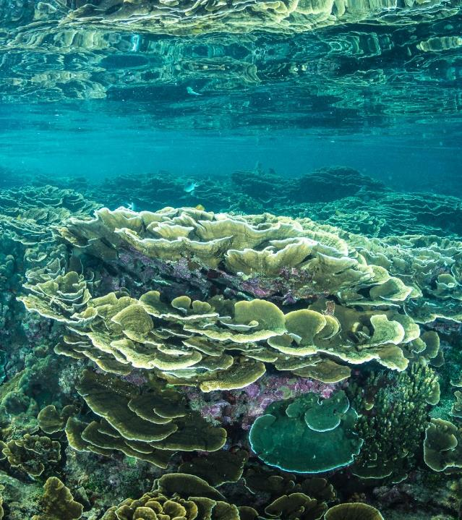
Values, condition and drivers of health of the Great Barrier Reef
Authors and contributors (in question order – 18 total): Maxine Newlands, Oluwatosin Olayioye, Len McKenzie, Mari-Carmen Pineda, Alana Grech, Angus Thompson, Aaron Davis, Richard Pearson, Katharina Fabricius, Aimee Brown, Al Songcuan, Catherine Collier, Sven Uthicke, Barbara Robson, Stephen Lewis, Zoe Bainbridge, Scott Smithers, Bianca Molinari
© Matt Curnock
Notes:
Jane

Slide 35
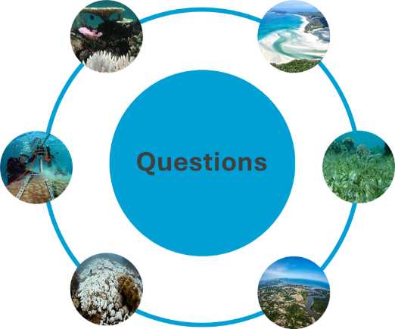
Values, condition and drivers of health of the Great Barrier Reef | 1,023 studies
Socio-ecological, cultural, economic and intrinsic values of the Great Barrier Reef
Climate change and water quality interactions
H
H
Lead author: Sven Uthicke
Lead author: Maxine Newlands
Evidence for changes in land-based runoff from pre-development estimates
Extent, condition and threats
Lead author: Len McKenzie
Lead author: Steve Lewis
H
M-H
Current and predicted impacts of climate change on Great Barrier Reef and water quality
H
Catchment to reef connections
H
Lead authors: Aaron Davis & Richard Pearson
Lead author: Katharina Fabricius
Notes:
Jane

Slide 36
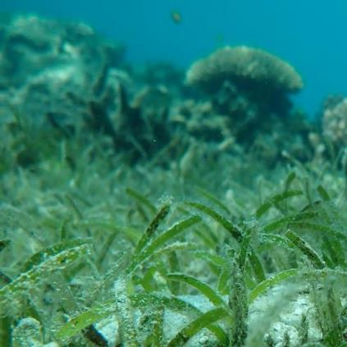
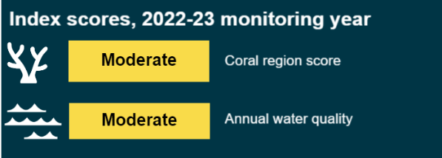
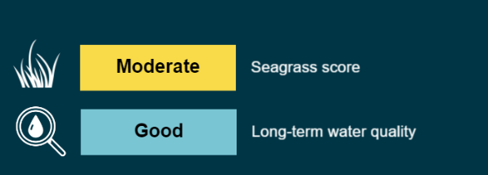
Current condition of the Great Barrier Reef
Since the 2017 Scientific Consensus Statement, the condition of inshore coral reef ecosystems has declined, while coral cover on shallow mid- and outer shelf reefs has shown clear recovery following repeated mass bleaching, tropical cyclones and/or crown-of-thorns starfish outbreaks (excludes 23-24 summer).
Partial recovery has been observed in inshore seagrass meadows in some locations.
Historical loss of some wetland types has been substantial, but condition trends for mangroves and wetlands have stabilised.
© Dieter Tracey
Notes:
Jane – mention that Steve and Negs will cover off on impacts of sediments and pesticides respectively

Slide 37
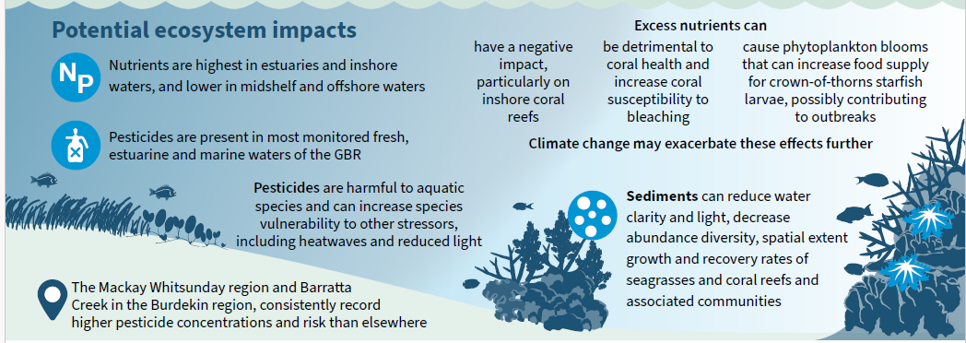
Impacts of pollutants on GBR ecosystems
Impacts vary between pollutants and locations.
Improved knowledge around specific impacts in some locations (e.g. sediment story), interactive effects and role of good water quality in recovery.
Included in Topic Summaries.
Example from Sugarcane Topic Summary
Notes:
Jane

Slide 38
Visit the website
2022 Scientific Consensus Statement
Land-based impacts on Great Barrier Reef water quality and ecosystem condition
Notes:
All outputs and process documents available for download.
Joint media release from C₂O and science organisations, government to follow
Post-release – WQIP seminar and P2R forums

