Slide 1
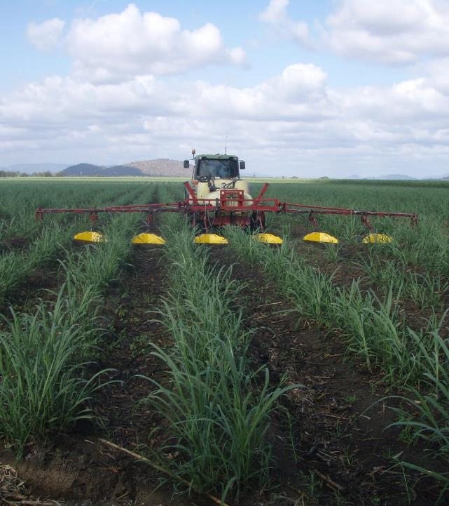
Pesticides and other pollutants
Presenters: Andrew Negri and Aaron Davis
Other lead authors and contributors (in question order – 15 total): Andrew P Negri, Grechel Taucare, Peta Neale, Catherine Neelamraju, Hayley Kaminski, Reiner M Mann, Michael St J Warne, Michelle Templeman, Sarah McDonald, Aaron Davis, Mark Silburn, Tony Weber, Megan Star, Anthony Chariton, Natalie Hejl
© Aaron Davis
© Matt Curnock
Notes:
Negs - online

Slide 2
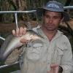
Pesticides and other pollutants | 683 studies
Q6.1 Spatial and temporal distribution of other pollutants, risks and primary sources
Q5.1 Spatial and temporal distribution of pesticides, ecological impacts and risk
L-M
H
Lead author: Anthony Chariton
Macquarie University
Lead author: Andrew Negri
Australian Institute of Marine Science
Questions
Q5.3 Effective management practices for reducing pesticide risk
Q5.2 Delivery and sources of pesticides
M
M-H
Lead author: Aaron Davis
TropWATER, James Cook University
Lead author: Shelley Templeman
TropWATER, James Cook University
Notes:
Negs

Slide 3
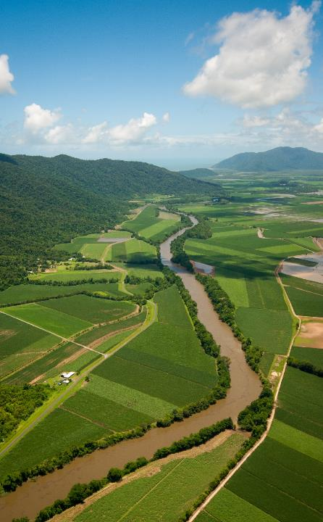
Pesticides and other pollutants
Pesticides frequently occur at concentrations that exceed protection guidelines for freshwater ecosystems of the Great Barrier Reef, particularly during the first flush of each wet season.
Exceedances also occur in inshore marine waters but are less frequent and typically associated with flood plumes.
The risk that pesticides pose to aquatic organisms reduces with distance from their source.
Management practices have been shown to reduce pesticide losses.
Too little is known about the distribution, concentrations and impacts of other pollutants on the Great Barrier Reef to comprehensively assess environmental risk
© Dieter Tracey
Notes:
Negs

Slide 4
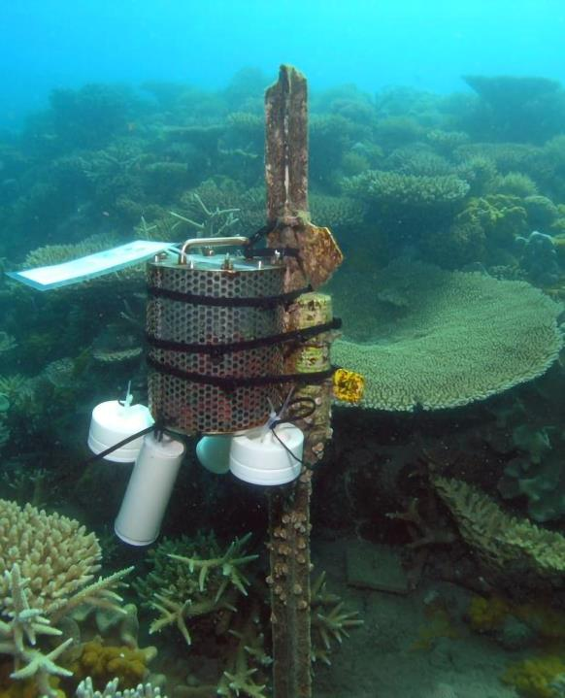
Pesticides: 5.1
Pesticide mixtures are present in the vast majority of all monitored fresh, estuarine and marine waters of the Great Barrier Reef.
The Mackay Whitsunday region and Barratta Creek in the Burdekin region, consistently record higher concentrations and risk than elsewhere.
© AIMS
Notes:
Negs

Slide 5
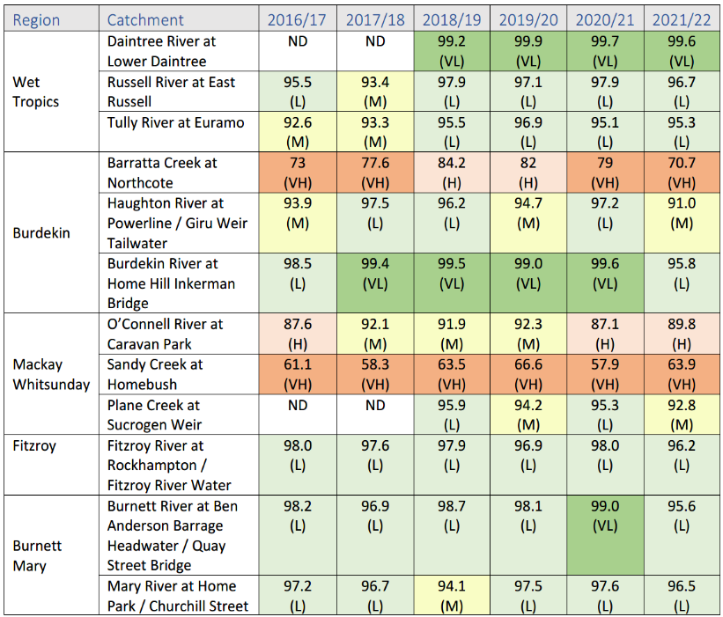
End of Burdekin
Catchment Loads Monitoring Program (GBRCLMP)
Risk:
Diuron (5-40%)
Atrazine (21-28%)
Imidacloprid (12-35%)
Isoxaflutole Barratta Ck (7-13% from 2020-22)
Notes:
Negs

Slide 6
Pesticides: 5.1
Pesticide mixtures are present in the vast majority of all monitored fresh, estuarine and marine waters of the Great Barrier Reef.
The Mackay Whitsunday region and Barratta Creek in the Burdekin region, consistently record higher concentrations and risk than elsewhere.
Long-term analyses indicate that photosystem II herbicide concentrations have increased in some inshore sites of the Great Barrier Reef between 2005 and 2018.
© AIMS
Notes:
Negs

Slide 7
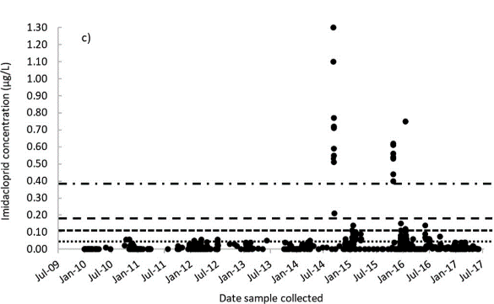
Pesticides: 5.1
Pesticide mixtures are present in the vast majority of all monitored fresh, estuarine and marine waters of the Great Barrier Reef.
The Mackay Whitsunday region and Barratta Creek in the Burdekin region, consistently record higher concentrations and risk than elsewhere.
Long-term analyses indicate that photosystem II herbicide concentrations have increased in some inshore sites of the Great Barrier Reef between 2005 and 2018.
Warne et al., 2022
© AIMS
Notes:
Negs

Slide 8
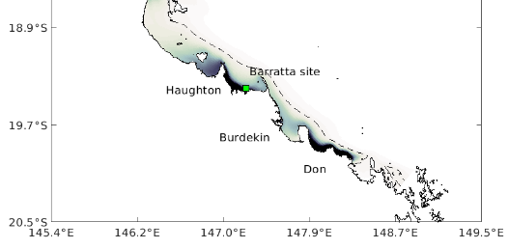
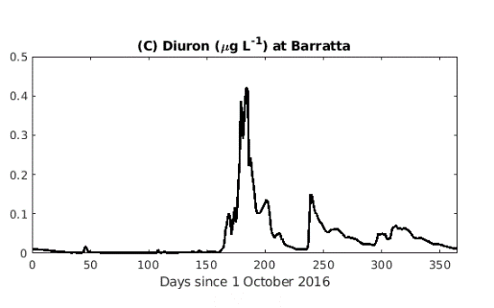
Pesticides: 5.1
Pesticide mixtures are present in the vast majority of all monitored fresh, estuarine and marine waters of the Great Barrier Reef.
The Mackay Whitsunday region and Barratta Creek in the Burdekin region, consistently record higher concentrations and risk than elsewhere.
Long-term analyses indicate that photosystem II herbicide concentrations have increased in some inshore sites of the Great Barrier Reef between 2005 and 2018.
Skerratt et al., 2023
© AIMS
Notes:
Negs

Slide 9
Pesticides: 5.1
Pesticide mixtures are present in the vast majority of all monitored fresh, estuarine and marine waters of the Great Barrier Reef.
The Mackay Whitsunday region and Barratta Creek in the Burdekin region, consistently record higher concentrations and risk than elsewhere.
Long-term analyses indicate that photosystem II herbicide concentrations have increased in some inshore sites of the Great Barrier Reef between 2005 and 2018.
Almost all tested pesticides are reported as harmful to non-target aquatic species of the Great Barrier Reef.
Pesticides can increase the vulnerability of local aquatic species to other stressors, including heatwaves.
© AIMS
Notes:
Negs

Slide 10
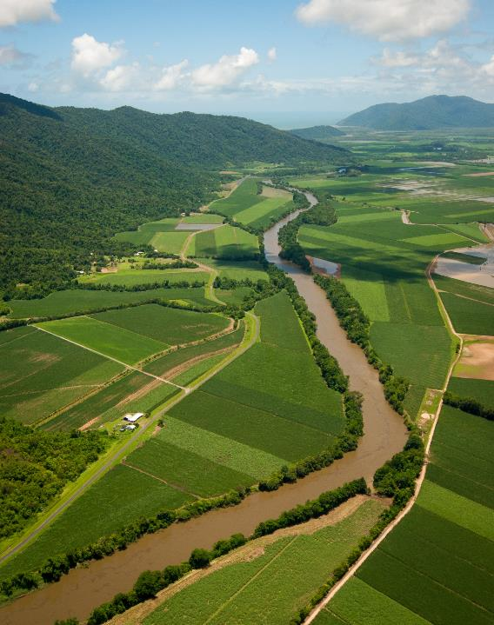
Pesticide sources & drivers
Sugarcane remains the main source of pesticides, with other agricultural and urban sources also contributing.
Pesticide export is influenced by the timing and rate of application, rainfall, irrigation regimes, and pesticide and soil properties.
Application rate and time between application and rainfall continue to be the biggest drivers of pesticide export from sugarcane.
© Rob Milla
© Rob Milla
© Dieter Tracey
Notes:
Aaron – in room

Slide 11
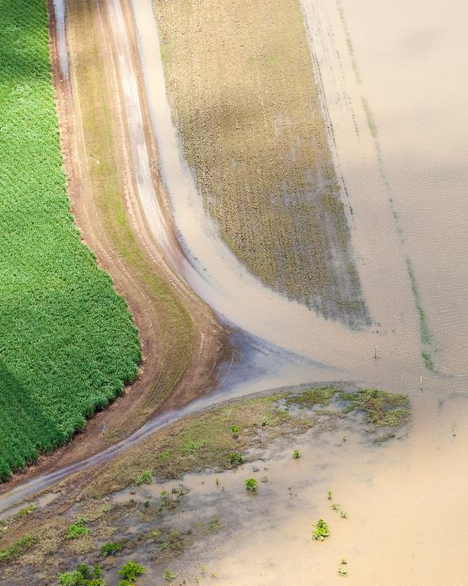
Pesticide sources & drivers
The longer the timeframe from application to an event causing runoff, the lower the relative amount of pesticide exported.
Critical time period for pesticide runoff is 1-25 days after application.
The first rainfall event of the wet season (typically described as the ‘first flush’ event) often delivers the greatest proportion of pesticides to the GBR.
Similarly for irrigated areas, the greatest losses tend to be associated with the first irrigation event.
Pesticide contributions typically reduce with subsequent rainfall events.
Pesticide export profiles from irrigated sugarcane are similar to rainfall events, but irrigation can lead to higher ecological risk in receiving systems due to extended periods of exposure and limited flushing or dilution.
© Matt Curnock
Notes:
Aaron

Slide 12
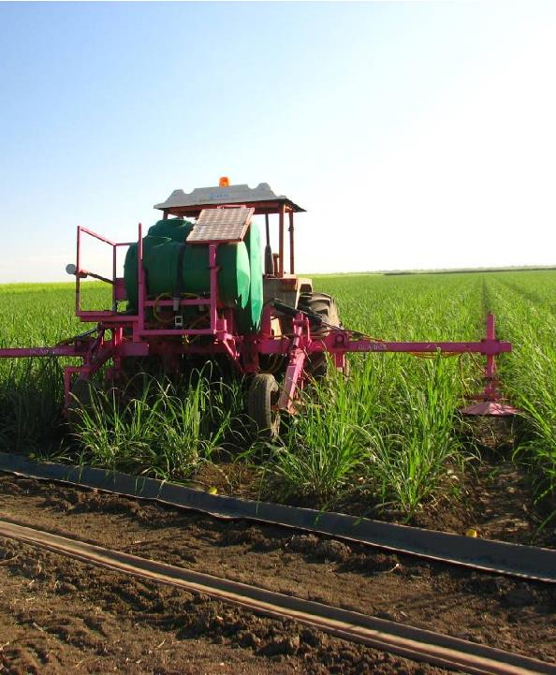
Pesticide management
The most effective management practices to reduce pesticide risk from agricultural land uses include:
Reducing the total amount of pesticide applied (within label recommendations)
Optimising application methods
Timing application to coincide with periods with a low chance of rainfall runoff
Choosing pesticides with lower environmental risk
Reducing soil erosion
Improving irrigation efficiency
© Rob Milla
© Rob Milla
Notes:
Aaron

Slide 13
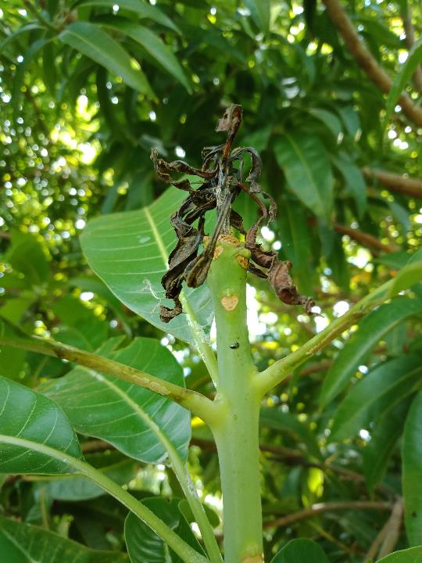
Pesticide management
Pesticide resistance likely to impose considerable changes in pesticide use and other alternative pest control measures.
A range of non-chemical pesticide control measures (integrated pest management, cultural controls that modify the pest’s growing environment) hold considerable potential for reducing reliance on chemical control measures.
However, most are yet to be trialled with respect to long-term pesticide use reductions, efficacy and economic outcomes.
Data required to assess the management effectiveness of many insecticides and fungicides used in Great Barrier Reef farming systems is particularly lacking.
© QDAF
© Rob Milla
Notes:
Aaron

Slide 14
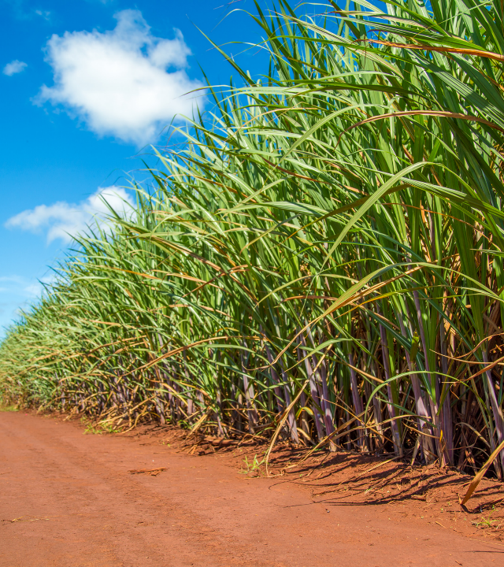
Pesticide management – challenges & costs
Lack of frameworks, risk-based metrics and inconsistent assessment methods for cost-effectiveness have posed challenges for assessing pesticide management practice change.
Economic returns remain critically dependent on region-specific variables including biophysical characteristics and enterprise structure, especially in relation to farm size and location.
For sugarcane, progressing from traditional to industry standard herbicide management was reported to be generally profitable and provide return on investment across all farm sizes and sugarcane districts.
© Rob Milla
© Rob Milla
Notes:
Aaron

Slide 15
Visit the website
2022 Scientific Consensus Statement
Land-based impacts on Great Barrier Reef water quality and ecosystem condition
Notes:
All outputs and process documents available for download.
Joint media release from C₂O and science organisations, government to follow
Post-release – WQIP seminar and P2R forums

