Slide 1
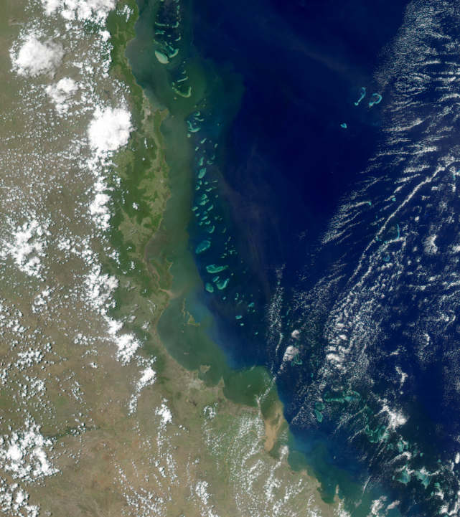
Dissolved nutrients
Presenter: Peter Thorburn
Authors and contributors (in question order – 35 total): Barbara Robson, Aimee Brown, Sven Uthicke, Guillermo Diaz-Pulido, Catalina Reyes-Nivia, Maria Fernanda Adame, Angela Arthington, Catherine Collier, Catherine Lovelock, Ciemon Caballes, Katie Sambrook, Morgan Pratchett, Ian Prosser, Scott Wilkinson, Michele Burford, Jianyin (Leslie) Huang, Zoe Bainbridge, Joanne Burton, Mohammad Bahadori, Gillian McCloskey, Michael Newham, Peter Thorburn, Kirsten Verburg, Marina Farr, Tony Weber, Maria Vilas, Caleb Connolly, Rohan Eccles, Nathan Waltham, Katie Motson, Bianca Molinari, Megan Star, Syezlin Hasan, James C. R. Smart, Carla Wegscheidl
Notes:
Peter - onlline

Slide 2
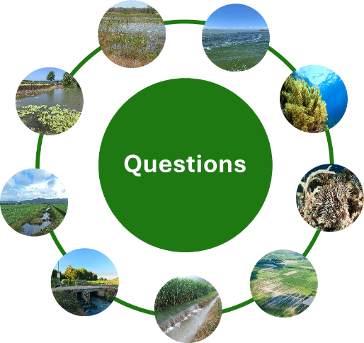
Dissolved nutrients | 1,272 studies
Role of natural/near natural wetlands in provision of ecosystem services
Spatial and temporal distribution
M
M
Lead author: Barbara Robson
Lead author: Nathan Waltham
Impacts on Great Barrier Reef ecosystems
Measured costs & costs drivers of wetlands & other treatment systems
M
M
Lead author: Guillermo Diaz-Pulido
Lead author: Megan Star
Questions
Drivers of crown-of-thorns starfish outbreaks
M
Efficacy of wetlands in improving water quality
M
Lead author: Ciemon Caballes
Lead author: Nathan Waltham
Effective management practices, costs, variability and production outcomes
Quantity, characteristics and sources
H
Lead author: Ian Prosser
M
Primary biophysical drivers of export & changes over time
Lead author: Peter Thorburn
M
Lead author: Michele Burford
Notes:
Peter

Slide 3
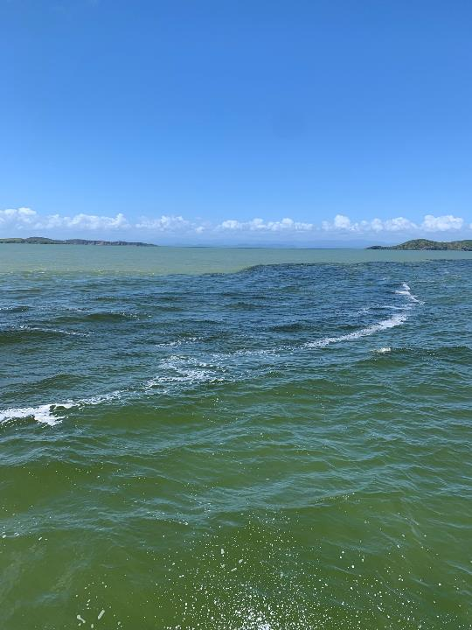
Dissolved nutrients
Agricultural development, especially sugarcane, and landscape modification have substantially increased nitrogen and phosphorus (nutrient) exports to the Great Barrier Reef, with dissolved inorganic nitrogen exports 1.5 to 3 times pre-development rates.
Reducing fertiliser application to industry recommended rates is the most effective and profitable practice for reducing nutrient exports.
Natural and near natural wetlands, and healthy rivers have the potential to support water quality improvements but are understudied in the Great Barrier Reef.
© Jane Mellors
Notes:
Peter

Slide 4
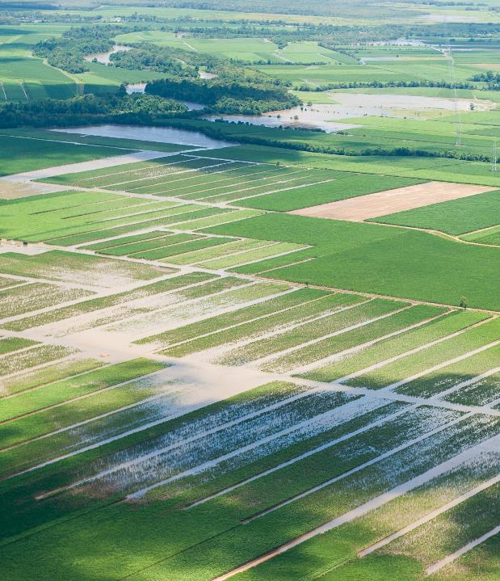
Dissolved nutrients
Basins dominated by sugarcane make the greatest contribution to dissolved inorganic nitrogen exports (42% of total).
Grazing lands contribute 22%, and although other land uses contribute smaller amounts, they can be locally important.
Increased erosion from grazing and other land uses can contribute to nutrient export, with transformation of particulate nutrients to dissolved form (termed bioavailable nutrients) during transport.
The primary drivers of anthropogenic nitrogen and phosphorus export are fertiliser application, changed catchment hydrology and erosion.
© Dieter Tracey
© Dieter Tracey
Notes:
Peter

Slide 5
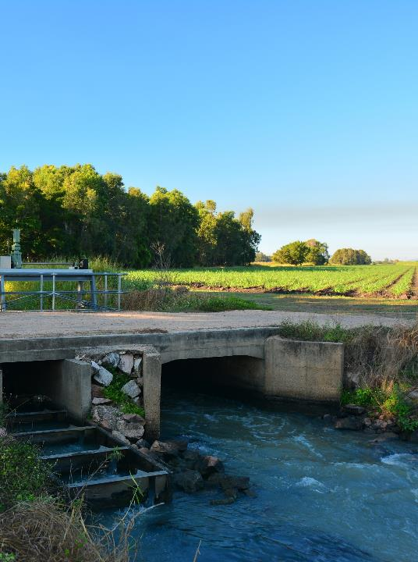
Dissolved nutrients: Practices
The most effective management practice to reduce dissolved inorganic nitrogen exports from sugarcane is reducing fertiliser applications. However, optimum application rates are uncertain, and large reductions may impact on productivity and profitability, which impedes adoption of reduced rates.
The effectiveness of other management practices for nitrogen in sugarcane is variable and/or not clearly demonstrated.
The evidence for improving water quality through the management of phosphorus in crop production, and nitrogen in the production of crops other than sugarcane, is limited. The same is true for cost-effectiveness of most practices.
Reducing erosion reduces both particulate and dissolved nutrients, although the transformation processes from particulate to dissolved forms are poorly understood.
© Matt Curnock
Notes:
Peter

Slide 6
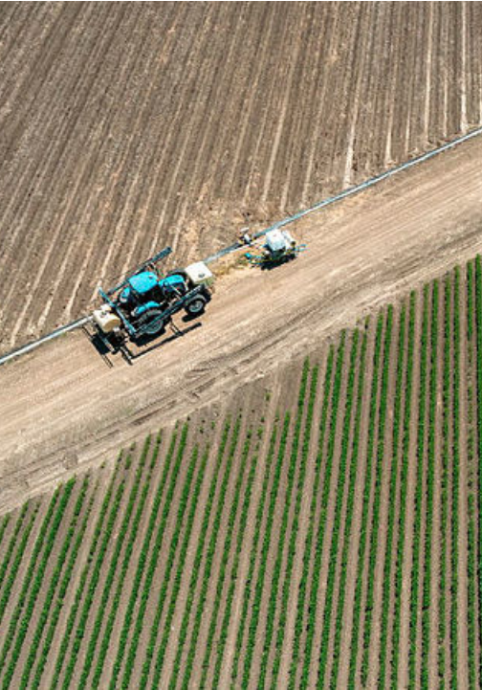
Dissolved nutrients: Irrigation
Little information on effect of improved irrigation practices on discharges of DIN and dissolved P, or on farm productivity.
Most information on the potential water quality benefits of improved irrigation comes from mechanistic modelling studies.
Well-designed and managed automated furrow irrigation systems on sugarcane farms can be profitable, although the water quality outcomes of these systems are not clear.
Limited evidence suggests that converting to a fully automated irrigation system on banana farms may provide economic benefits.
Very high irrigation efficiency resulting from low irrigation application rates is likely to reduce DIN discharges from sugarcane crops, but there is a risk that productivity is also reduced. Most of these studies do not provide enough detail on the methods or results to draw reliable conclusions about the water quality and economic outcomes.
© GBRF
Notes:
Peter

Slide 7
Dissolved nutrients: EEF
Applying N through EEF has the potential to reduce N losses, potentially allowing crops to take up N for longer.
Benefits highly variable across sites and years. Variability explained by three prerequisites needed for EEF to be effective:
1) Length of time that N is maintained in the soil must be close to that over which crops are taking up N.
2) Must be rainfall events while the N is in the less mobile form that would otherwise cause that N to be lost from the soil.
3) Crop growth must be able to respond to additional N in the soil. Crops will not respond to additional N if, for example, they have already taken up all the N they need, or their growth is constrained by some other factor (e.g. waterlogging).
These prerequisites, plus the climate and soil complexity in the relationship in N application rates and yields, cause high variability. Clear benefits are often only seen when data are aggregated across sites and seasons.
© Matt Curnock
Notes:
Peter

Slide 8
Dissolved nutrients: Wetlands
The global evidence indicates that tropical wetland systems can retain, process and, at times, export nutrients.
It also shows that natural and near-natural wetlands are typically more effective at removing some forms of nutrients than constructed or restored wetlands.
Hydrology, maintenance and presence of vegetation are important factors for maximising nutrient removal efficiency.
There are few studies from the Great Barrier Reef that measure or model the efficacy or cost of wetlands as a water quality improvement tool.
The historical loss of natural wetlands, particularly in floodplains, the degradation of those remaining, the presence of vegetation, hydrological characteristics, and the need for ongoing and long-term maintenance of restored wetlands are important considerations for maximising nutrient removal efficiency and determining future protection and management opportunities for Great Barrier Reef wetlands.
© Ciemon Caballes
© Nathan Waltham
Notes:
Peter

Slide 9
Visit the website
2022 Scientific Consensus Statement
Land-based impacts on Great Barrier Reef water quality and ecosystem condition
Notes:
All outputs and process documents available for download.
Joint media release from C₂O and science organisations, government to follow
Post-release – WQIP seminar and P2R forums

