Slide 1
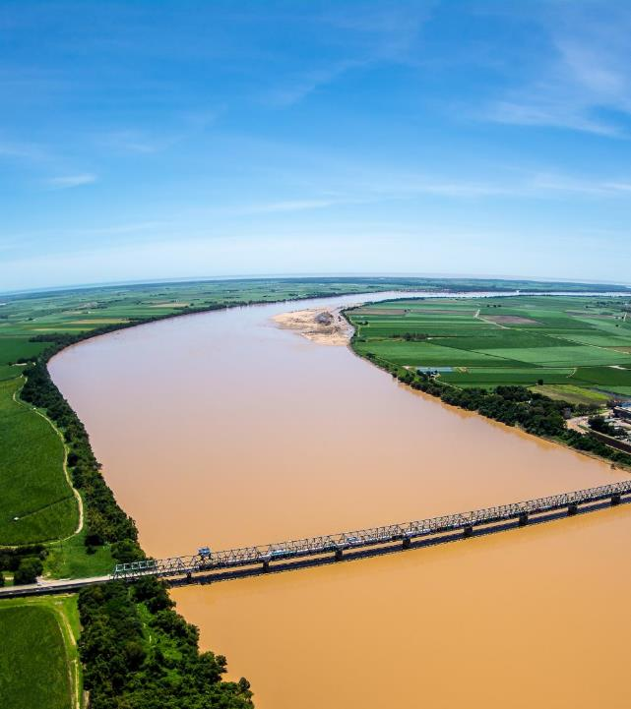
Sediments & particulate nutrients
Presenter: Steve Lewis
Authors and contributors (in question order – 15 total): Stephen Lewis, Zoe Bainbridge, Scott Smithers, Catherine Collier, Aimee Brown, Katharina Fabricius, Guillermo Diaz-Pulido, Fernanda Adame, Ian Prosser, Scott Wilkinson, Bruce Murray, Rebecca Bartley, Andrew Brooks, James Daley, Tim Pietsch
© Matt Curnock
Notes:
Steve

Slide 2
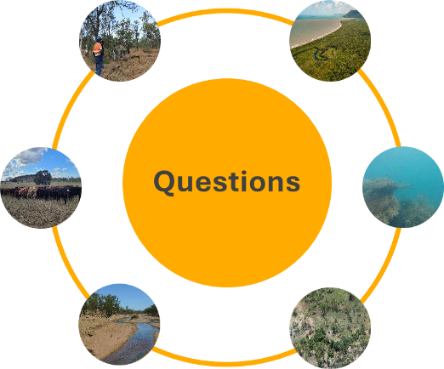
Sediments and particulate nutrients | 850 studies
Effectiveness of gully & streambank restoration, variability, costs & production outcomes
M
Spatial and temporal distribution
Lead author: Andrew Brooks
H
Lead author: Steve Lewis
Effective management practices, costs, variability and production outcomes
Impacts on Great Barrier Reef ecosystems
Lead author: Rebecca Bartley
Lead author: Catherine Collier
M
M
Primary biophysical drivers of export & changes over time
M
Quantity, characteristics and sources
H
Lead author: Scott Wilkinson
Lead author: Ian Prosser
Notes:
Steve

Slide 3
Sediments and particulate nutrients
Exports of fine sediment and particulate nutrients from catchments to the Great Barrier Reef are 1.4 to 5 times higher than pre-development rates.
Increased delivery of land-based fine sediment and particulate nutrients reduces the quality and quantity of light in Great Barrier Reef ecosystems, with impacts on inshore seagrass meadows and coral reefs.
Management is most effective when targeted to sediment and particulate nutrient hotspots which can occur in all land uses from gully, streambank or hillslope erosion.
© Matt Curnock
Notes:
Steve

Slide 4
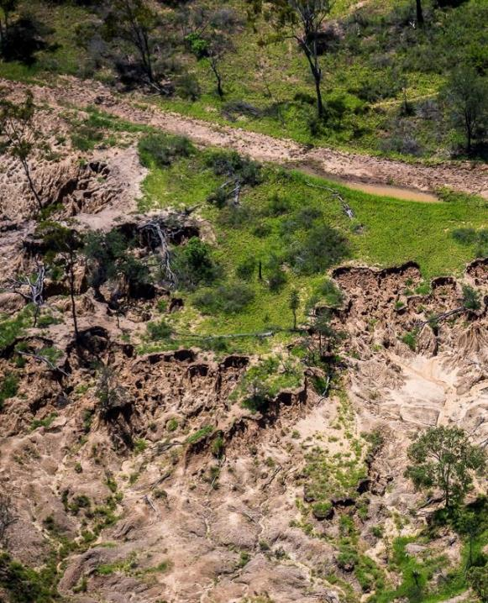
Sediments and particulate nutrients
Land used for grazing is the largest contributor of fine sediments, because it is by far the biggest land use by area (73%); other intensive land uses can generate large amounts of fine sediment locally but cover a smaller area.
The main drivers of anthropogenic sediment and particulate nutrient exports are overgrazing, land clearing, tillage and other soil disturbances.
Modelling and observations show that about half of the sediment exported comes from gully erosion, with hillslope and streambank erosion accounting almost equally for the other half.
Much of the export comes from a relatively small area. For example, in the Bowen catchment, 30% of the sediment from gully erosion comes from just 2% of the gullies.
© Matt Curnock
Notes:
Steve

Slide 5
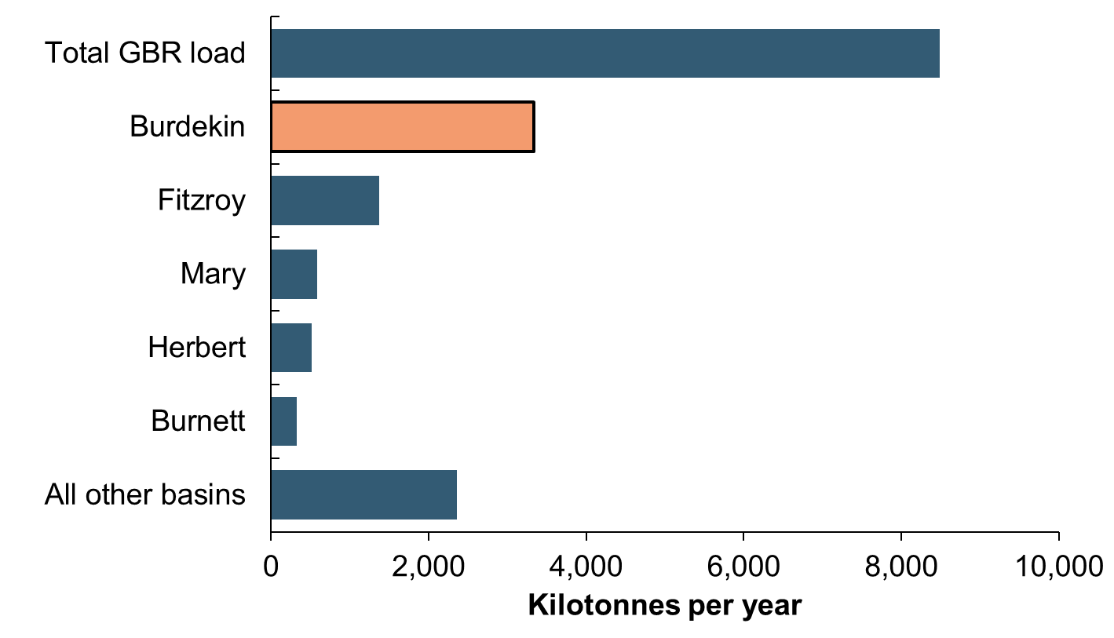
Burdekin basin is a major sediment source
Single largest contributor of fine sediment accounting for, on average, 40% of the total load (3.6 Mt) delivered from the catchment area to the Great Barrier Reef.
Total suspended sediment loads by basin
Notes:
Steve

Slide 6
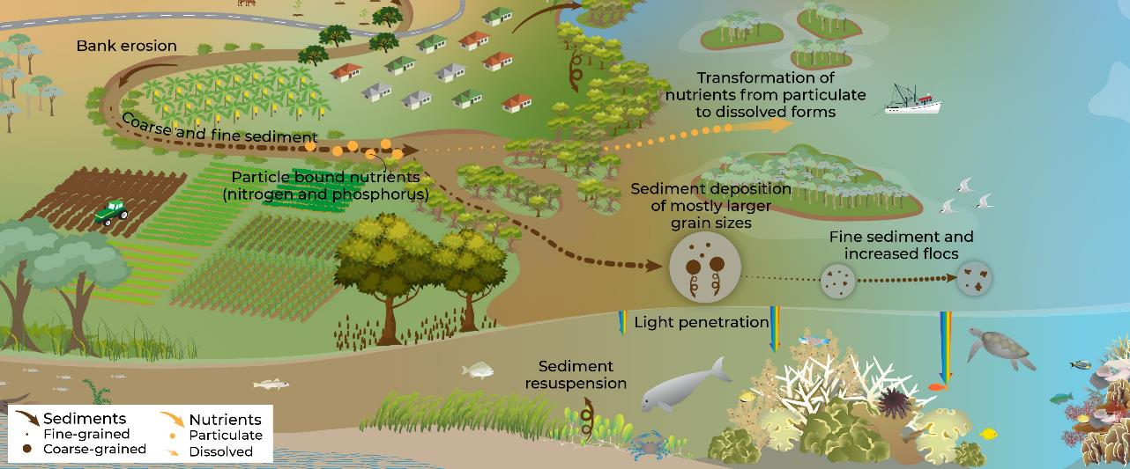
Burdekin summary
Estimated that the load has increased by 5 times since the arrival of Europeans. This increase is supported by monitoring, modelling, catchment erosion tracing studies, sediment cores and coral cores.
Notes:
Steve

Slide 7
Burdekin summary
Monitoring of Burdekin flood plumes show it is the fine sediment (< 20 um) fraction that travels furthest (> 100 kms) in the Great Barrier Reef lagoon with the coarser fractions settling near the river mouth.
Notes:
Steve

Slide 8
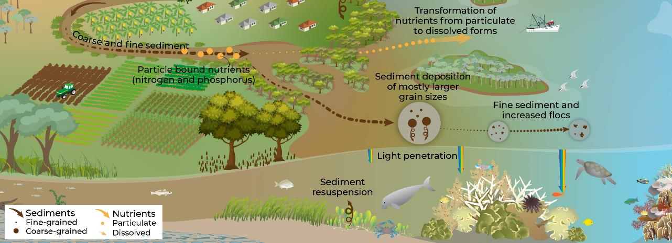
Burdekin summary
It is this fine sediment that travels the furthest that impacts on water clarity in the inshore Great Barrier Reef (and potentially middle shelf). This ‘newly delivered’ fine sediment is more easily resuspended and can influence water clarity for up to 6 months following a large flood event.
Reduced water clarity affects light available for seagrass meadows and coral reefs.
Notes:
Steve

Slide 9
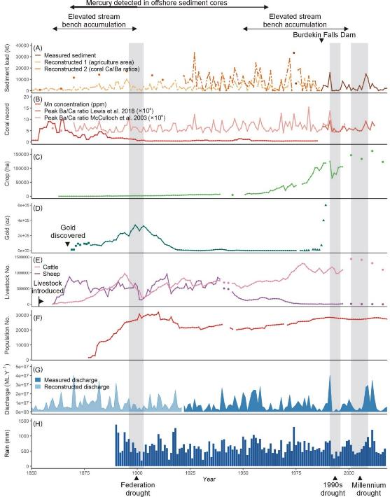
Burdekin Basin case study
Narrative of landscape change and compilation of environmental histories
Biophysical records
Sediment loads
Coral records
Cropping
Mining
This could take a bit too long Steve – but as long as you are not going to describe each plot.
Probably good idea to take out a few key messages and not try to talk to the whole thing.
Interestingly the sediment loads don’t look like 5 times increase?!
Livestock
Population
River discharge
Rainfall
Notes:
Steve

Slide 10
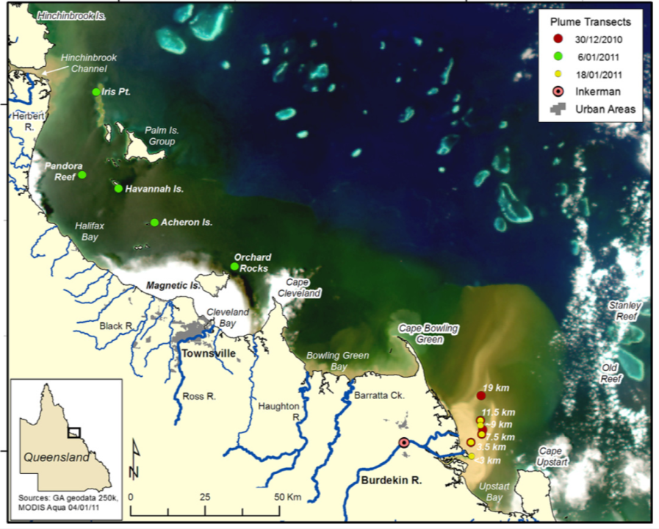
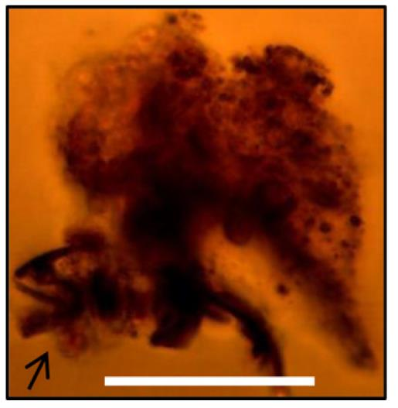
Bainbridge et al. (2012)
Sediment floc
Not sure if this is a bit technical for the audience – but I know its important so leave it in
Range between 1 and 19 µm
Most sediment
falls out here
100 µm
Notes:
A microphotograph of a sediment floc in the Burdekin River plume showing the various components of the floc. Note the ‘mineral’ sediment particles are all <16 µm and are surrounded by organic-rich materials (Research question: what are fuelling these organics? Particulate nitrogen, particulate phosphorus, dissolved inorganic N or P etc).

Slide 11
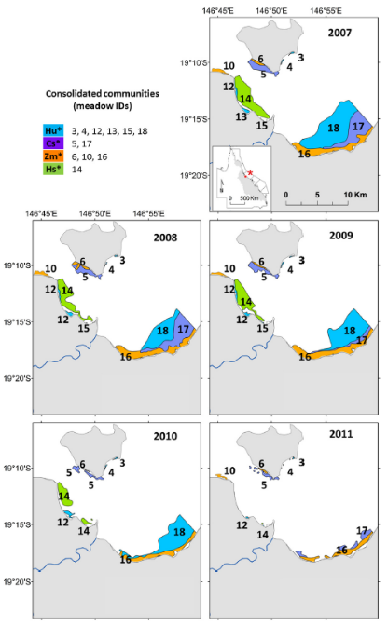
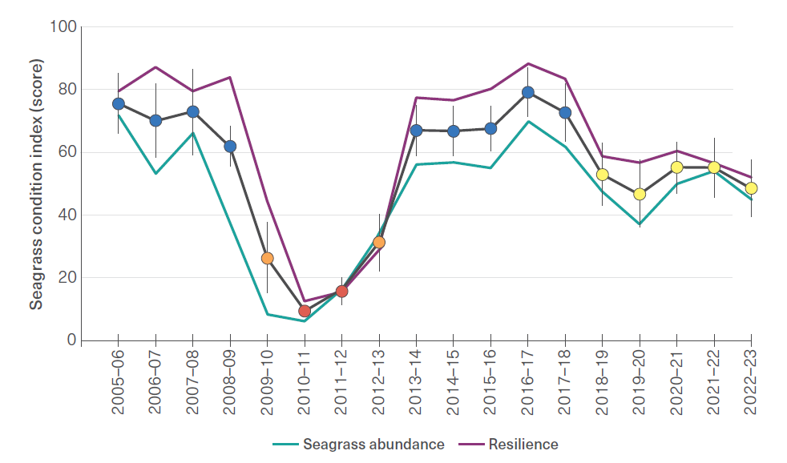
Seagrass health in Cleveland Bay
GBR Outlook Report 2024 from Marine Monitoring Program
Petus et al. (2014)
Notes:
Steve

Slide 12
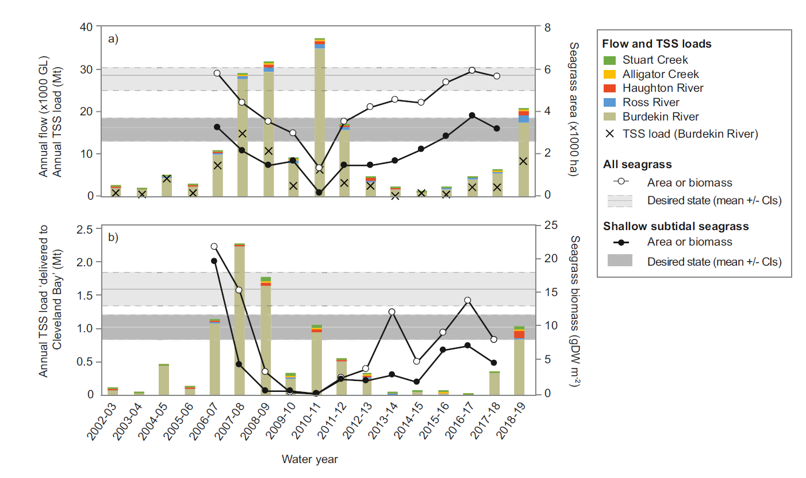
Link between discharge/sediment load and condition
Target = between 35% and 45% reduction
Lambert et al. (2021)
Notes:
Steve

Slide 13
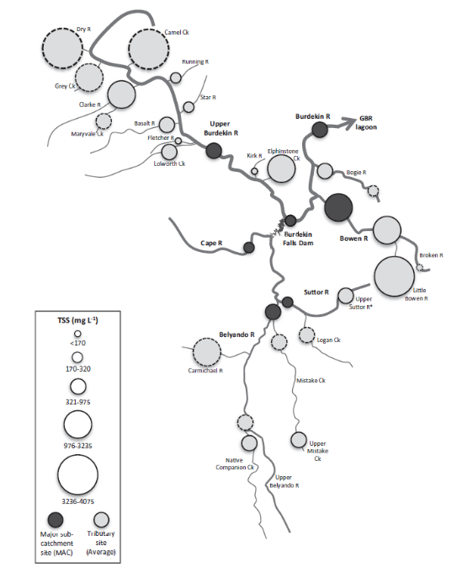
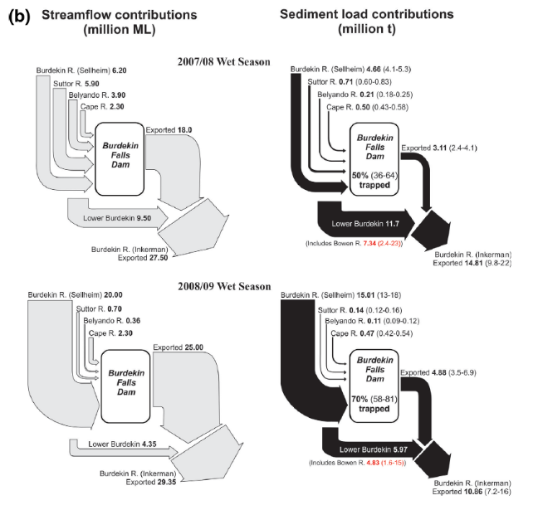
Sediment budget
Total suspended sediment loads
Size of circles represents amount contributed
GBR lagoon
Bainbridge et al. (2014)
Notes:
Steve

Slide 14
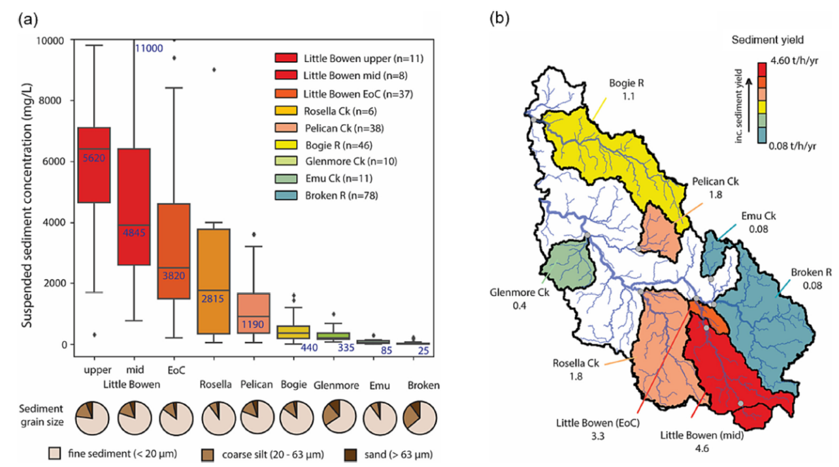
Bainbridge et al. (2023)
Notes:
Steve

Slide 15
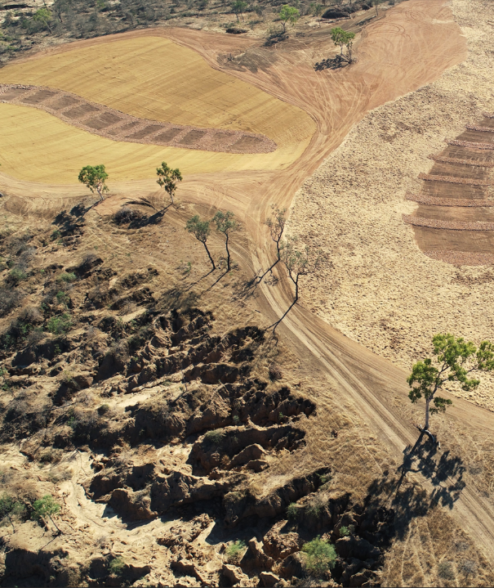
Sediments and particulate nutrients
Land management and remediation are most cost-effective when targeted at hotspots of fine sediment and particulate nutrient export.
Large-scale remediation of gullies can reduce sediment exports by more than 90% in restored gullies within 1 to 2 years.
Maximising revegetation of streambanks and channels is expected to reduce erosion, but the water quality benefits have not been quantified in the Great Barrier Reef catchment area.
To reduce hillslope erosion, management should aim to maintain more than 70% ground cover.
Retention and protection of existing vegetation is important for reducing erosion.
© Damon Telfer
Notes:
Steve

Slide 16
Visit the website
2022 Scientific Consensus Statement
Land-based impacts on Great Barrier Reef water quality and ecosystem condition
Notes:
All outputs and process documents available for download.
Joint media release from C₂O and science organisations, government to follow
Post-release – WQIP seminar and P2R forums

